Slide 1


Understand IoT message processing, analytics, and business integration
Pamela Cortez |
Microsoft, Azure IoT
@AltaOhms
/in/pamelacortezhellotechie

Slide 2
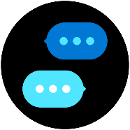
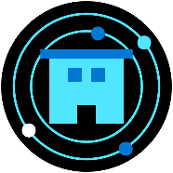
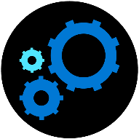

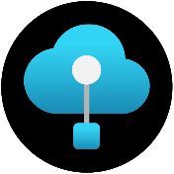
Build end to end IoT Solutions
Transform your business with IoT
Connect devices to the cloud
Provision devices at scale
Understand IoT message processing, analytics, and business integration
Build the intelligent edge
Build IoT solutions with Azure IoT Central
Notes:
Transform your business with IoT
To start this series, we’ll explain how the Internet of Things (IoT) addresses the problems of efficiency, productivity, safety, and security. We’ll describe Azure IoT components and explain how you combine them to create value for enterprises, enabling digital feedback loops for solutions that extend beyond telemetry with analytics and edge solutions that provide real-time status.
Create an Azure dashboard and resource group.
Create an IoT hub using the Azure portal.
Examine features of Azure IoT Hub.
Create a device provisioning service and link it to your IoT hub.
Connect devices to the cloud
In this session, you’ll learn how to set up the development environment used throughout this series. We’ll cover how to connect an IoT device that includes temperature and humidity sensors to Azure. In the labs, you’ll configure a simulated device to connect to Azure IoT Hub. Then you’ll run the simulated device to send telemetry messages and verify that device telemetry is being received.
Provision devices at Scale
This portion of the workshop walks through a hypothetical asset-monitoring solution that requires IoT devices with sensors for tracking location, temperature, and pressure to be placed in product transport boxes. When a new box enters the system, it is equipped with the new IoT device. The device needs to be autoprovisioned to the IoT hub using Azure’s device provisioning service. When the box arrives, the sensor is removed from the box and needs to be “decommissioned” through the device provisioning service. You’ll learn how you can use the device provisioning service to enroll many devices automatically and securely using X.509 certificate authentication.
Understand IoT message processing analytics and business integration
Preventive maintenance is a key IoT scenario—detect that something is wrong before there is any damage. In this module, you’ll write code to send continuous telemetry to an IoT hub that will use Azure Stream Analytics and a built-in machine learning model to warn of anomalies. Using Power BI to visualize the data stream, you’ll create an event subscription within Azure IoT Hub to set up Azure Event Grid integration that will trigger a logic app to send an alert. We’ll also cover working with time series data using Azure Time Series Insights.
Build the intelligent edge
With the collection of large amounts of data and the need for urgent responses, you’ll want to bring the intelligence to the edge for processing data and only send the important data to the cloud. We’ll take a deep dive on using an Azure IoT Edge device as a gateway and you’ll learn the different scenarios where an IoT Edge device is on an enterprise network (needs proxy settings) or needs extended offline capabilities.
Build solutions with IoT Central
Designed to enable the easy monitoring and management of a fleet of devices, Azure IoT Central encompasses a range of underlying technologies that work together well but can be complicated to implement when many technologies are needed. These technologies include Azure IoT Hub, the Azure device provisioning service, Azure Maps, and others. We’ll also take a look at IoT Plug and Play to interact with a device's capabilities even without knowledge of the underlying device implementation.

Slide 3
Agenda
Overview of IoT Architecture
IoT Data overview, Integrating IoT data, and Insights and Actions
Stream Processing with Azure Stream Analytics
Demo: Identify anomalies by routing data via IoT Hub to a built-in ML model in Azure Stream Analytics
Real-time actions with Logic Apps
Time Series Insights
Demo: Collect, store, model and visualize timeseries and historical data with Time Series Insights
Resources & Getting started

Slide 4
IoT Solution Architecture
THINGS
INSIGHTS
ACTION
Gain real time insights and improve business processes
Identify patterns in data, automate rules & alerts
Optimize operations, increase profitability, & create more compelling business models
IoT Devices
Custom
Cloud Gateways
Custom
Protocols
UI & reporting Tools
Configure and control
Visualize data and learnings
Constrained Devices
Field Gateways
Constrained Devices
Cloud Gateway (IoT Hub & Device Provisioning Service)
Stream Processing
Business Integration
Stream processing and
rules evaluations over data
Edge Devices
Intelligent
Edge
Edge Devices
Data Transformation
Machine Learning
Storage
Cold
Path store
Warm
Path store
IoT Devices
IP Capable devices
send data from devices to Cloud
Store data
Integrate with Business process
Notes:
The hot path analyzes data in near-real-time, as it arrives. In the hot path, telemetry must be processed with very low latency. The hot path is typically implemented using a stream processing engine. The output may trigger an alert, or be written to a structured format that can be queried using analytical tools.
The cold path performs batch processing at longer intervals (hourly or daily). The cold path typically operates over large volumes of data, but the results don't need to be as timely as the hot path. In the cold path, raw telemetry is captured and then fed into a batch process.
Stream processing. Stream processing analyzes large streams of data records and evaluates rules for those streams. For stream processing, we recommend Azure Stream Analytics. Stream Analytics can execute complex analysis at scale, using time windowing functions, stream aggregations, and external data source joins. Another option is Apache Spark on Azure Databricks.
Machine learning allows predictive algorithms to be executed over historical telemetry data, enabling scenarios such as predictive maintenance. For machine learning, we recommend Azure Machine Learning.
Warm path storage holds data that must be available immediately from device for reporting and visualization. For warm path storage, we recommend Cosmos DB. Cosmos DB is a globally distributed, multi-model database.
Cold path storage holds data that is kept longer-term and is used for batch processing. For cold path storage, we recommend Azure Blob Storage. Data can be archived in Blob storage indefinitely at low cost, and is easily accessible for batch processing.
Data transformation manipulates or aggregates the telemetry stream. Examples include protocol transformation, such as converting binary data to JSON, or combining data points. If the data must be transformed before reaching IoT Hub, we recommend using a protocol gateway (not shown). Otherwise, data can be transformed after it reaches IoT Hub. In that case, we recommend using Azure Functions, which has built-in integration with IoT Hub, Cosmos DB, and Blob Storage.
Business process integration performs actions based on insights from the device data. This could include storing informational messages, raising alarms, sending email or SMS messages, or integrating with CRM. We recommend using Azure Logic Apps for business process integration.
Device provisioning. For registering and connecting large sets of devices, we recommend using the IoT Hub Device Provisioning Service (DPS). DPS lets you assign and register devices to specific Azure IoT Hub endpoints at scale.
Quick recap from the Deciphering Data Introduction session
Things :
Directly connected, via a gateway, or intelligent edge devices
If you are a device developer you need to be thinking about message types, data types, serialisation, and metadata as these simply data processing in the cloud.
Insights
Stream processing, data transformation, and Storing
Remember to consider the volume and value of data as this will guide you as to where you are storing data
Actions
Integration with business systems
Make better business decision based on data
Opportunities to automate
Batch analytics and training machine learning

Slide 5
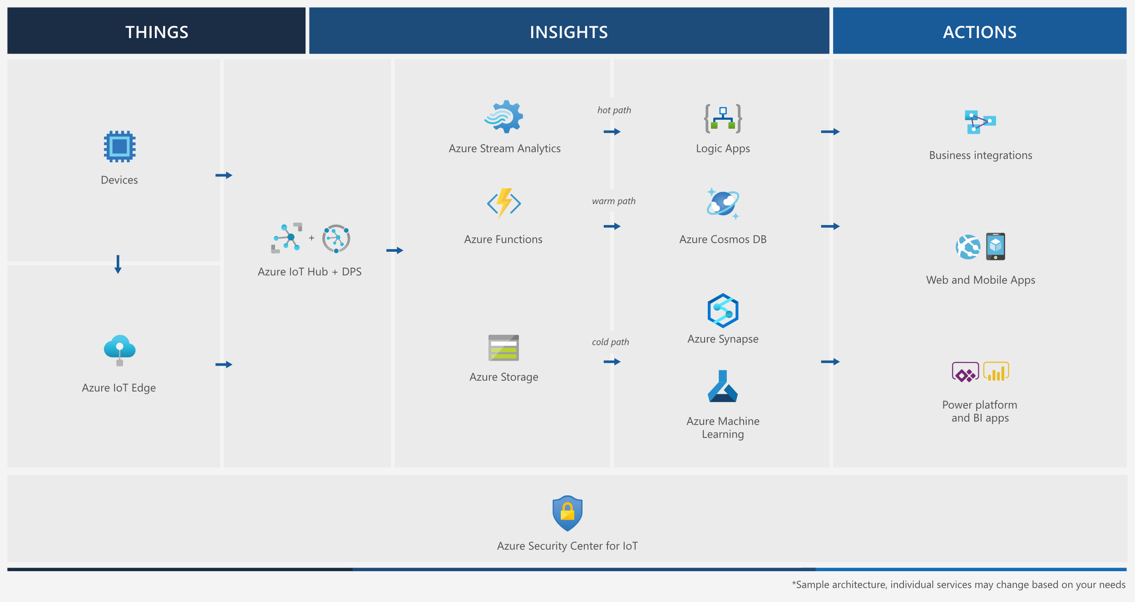
https://aka.ms/iotrefarchitecture
Notes:
Stream processing. Stream processing analyzes large streams of data records and evaluates rules for those streams. For stream processing, we recommend Azure Stream Analytics. Stream Analytics can execute complex analysis at scale, using time windowing functions, stream aggregations, and external data source joins. Another option is Apache Spark on Azure Databricks.
Machine learning allows predictive algorithms to be executed over historical telemetry data, enabling scenarios such as predictive maintenance. For machine learning, we recommend Azure Machine Learning.
Warm path storage holds data that must be available immediately from device for reporting and visualization. For warm path storage, we recommend Cosmos DB. Cosmos DB is a globally distributed, multi-model database.
Cold path storage holds data that is kept longer-term and is used for batch processing. For cold path storage, we recommend Azure Blob Storage. Data can be archived in Blob storage indefinitely at low cost, and is easily accessible for batch processing.
Data transformation manipulates or aggregates the telemetry stream. Examples include protocol transformation, such as converting binary data to JSON, or combining data points. If the data must be transformed before reaching IoT Hub, we recommend using a protocol gateway (not shown). Otherwise, data can be transformed after it reaches IoT Hub. In that case, we recommend using Azure Functions, which has built-in integration with IoT Hub, Cosmos DB, and Blob Storage.
Business process integration performs actions based on insights from the device data. This could include storing informational messages, raising alarms, sending email or SMS messages, or integrating with CRM. We recommend using Azure Logic Apps for business process integration.

Slide 6
IoT data overview
Notes:
Speaker transcript
We just saw that integrating IoT data into your Data Analytics landscape is possible. Now, let’s see some concrete examples on hot to get insights and actions from your IoT Data.

Slide 7
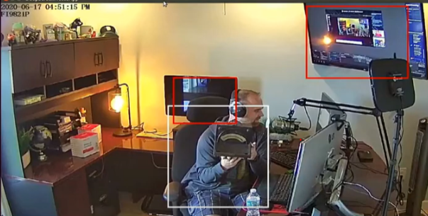
The nature of IoT Data
Unstructured bin
JSON Documents
Metadata
{
"TimeStamp": "2020-0812T13:58:07.5203217Z",
"Co": 20.6515621746199,
"Co2": 48.47952265338019,
"Ppm10": 257.44680750414,
"Ozone": 163.747165663515,
"EventProcessedUtcTime": "2020-08-12T13:58:13.2928373Z",
"PartitionId": 3,
"EventEnqueuedUtcTime": "2
020-08-12T13:58:08.08500Z"
DeviceId | 14f8gq51gq
Customer | ContosoCity
LocationGps | 43.5887 1.4522
DeviceType | AirQualityv2
Building | Main
BuildingType | School
Weather | Sunny
Wind (km/h) | 28
Notes:
Speaker Transcript
Let’s have a look at the variety of data IoT systems can generate.
[Click] First, IoT generates telemetry data. We have mainly JSON documents, even if from time to time, we encounter a lot of other data formats, including column-encoded.
[Click] Then, we have all the metadata associated with the data itself, the IoT Device or the system. The values there may change slowly¹ over time. These metadata can be precious sources of information for your analytics. [Click] These metadata can also be enriched in the process with reference data or other sources.
[Click] The diversity of IoT generated data can be immense: Image & video streams, but also many other formats. IoT Gateways like Azure IoT Hub facilitates file upload from IoT devices, enabling the collection of all kind of unstructured data.
Speaker Notes
1 – Slow changing dimension

Slide 8

Using IoT as an operational Data Source
?
Where to store our data ?
Azure IoT Hub
Where to process our data ?
Power BI
Cloud Gateway
Visualize Data
Notes:
Speaker transcript
When you start thinking about how to do it, two questions emerges.
In most IoT architectures, IoT Data goes through a central point – an IoT Gateway like Azure IoT Hub – that can dispatch incoming state and telemetry to downstream storages. The first question you may ask yourself is where can we store our IoT Data?
Then, your IoT Data will probably need to be refined and structured in a specific way, so you can run your analytics on it. Therefore, you’ll need a place to process this IoT Data.

Slide 9
Integrating IoT data

Slide 10
What are the challenges of integrating data?
Prepare data so the analysts can find and use it
Aggregate data to the right level
Duplicate data to different, specialized storage & analytics systems

Slide 11



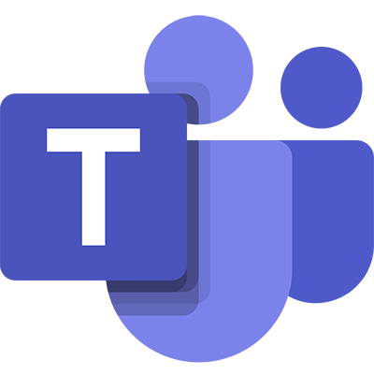




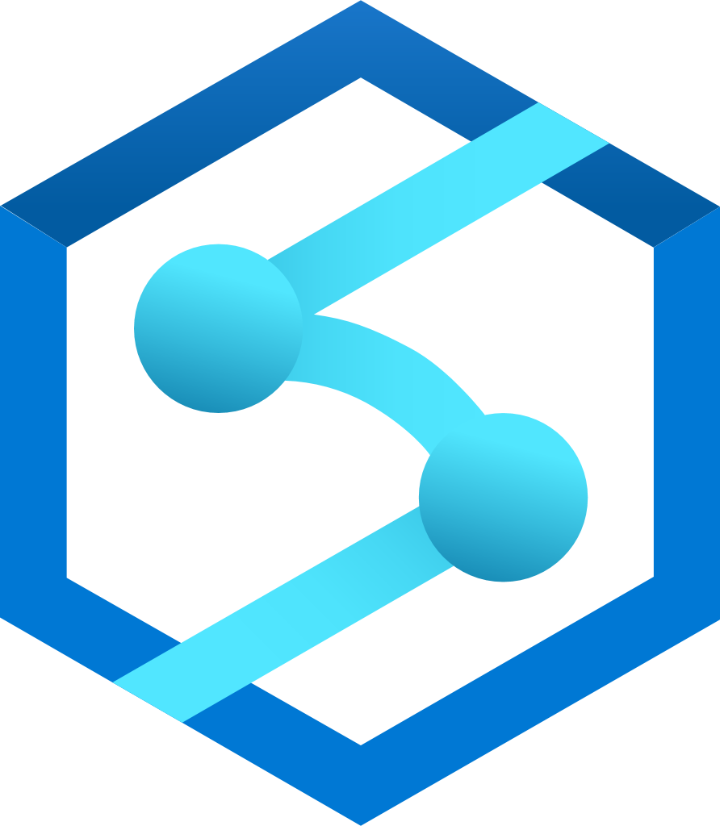

HOT PATH
Business services
Azure Stream Analytics
Teams
Event Hubs
Logic App
Azure IoT Hub
Time Series Insights
COLD PATH
Power BI
Azure Data Factory
Azure SQL Datawarehouse
Azure Synapse Analytics
Synapse Analytics
Azure SQL
Azure Data Lake Gen 2
Notes:
Let’s walk through both HOT path and cold path IoT architecture

Slide 12
Using IoT as an operational Data Source
Azure Stream Analytics
Azure IoT Hub
Store processed data
Power BI
Azure SQL Datawarehouse
Azure Synapse Analytics
Azure SQL
Store raw data
Azure Data Lake Gen 2
Notes:
Speaker transcript
Let’s have a look at this simple IoT Architecture.
On the left, we find our IoT Gateway. On the right our analytics and reporting tool, Power BI.
Along this presentation, we’ll build upon this simple architecture by adding services and features.
Let’s start with the raw storage [Click]. We’ll store all incoming telemetry in it’s raw format, directly an data Lake. This data will unlock all analytics and Machine Learning scenarios that may arise in the future.
Data analysts want harmonized (same field name and unit of measure) data. A cooked prepared meal,
While data scientists want to access the raw data, data analysts want harmonized data, a cooked meal If you want.
That’s why these data will also be processed and ingested into an analytical data store, here a Data Warehouse. For doing this, we’ll use Azure Stream Analytics service. With Azure Stream Analytics we can easily process and store data into several data stores including SQL Datawarehouse without having to deploy any complex service.
In very specific cases, some IoT Data can also be stored in a classical SQL Database. This is also something you can achieve with Stream Analytics.
Because cooked data often loses the golden nuggets data scientists are looking for, our current architecture – storing both raw and prepared data – enables a wide spectrum of analytics needs.

Slide 13
Azure Stream Analytics: Fully Managed PaaS offering for real-time analytics
Programmer productivity
Intelligent Edge, and Cloud
Serverless and low TCO
Easy to get started
Enterprise grade
Simple SQL language extensible with JavaScript and C#
Built-in Analytic functions
Azure Portal, VS Code, Visual Studio, PowerShell, REST APIs
Best in class debugging tools
Same queries running either on Edge, Cloud or Azure Stack
Leveraging IoT Edge for security and deployment
Fully managed Job service: no clusters to manage or VMs to provision
Pay as you go: pay by minute, start, stop on-demand
Scale-up and scale-out
Native, Zero code integration with 15+ Azure services
“<5 minutes to solution”
99.9% job level SLA
Highly certified and compliant
26 regions worldwide
Millisecond latencies
Notes:
Discover Azure Stream Analytics, the easy-to-use, real-time analytics service that is designed for mission-critical workloads. Build an end-to-end serverless streaming pipeline with just a few clicks. Go from zero to production in minutes using SQL—easily extensible with custom code and built-in machine learning capabilities for more advanced scenarios. Run your most demanding workloads with the confidence of a financially backed SLA

Slide 14
Insights and Actions from IoT data
Notes:
Speaker transcript
We just saw that integrating IoT data into your Data Analytics landscape is possible. Now, let’s see some concrete examples on hot to get insights and actions from your IoT Data.

Slide 15
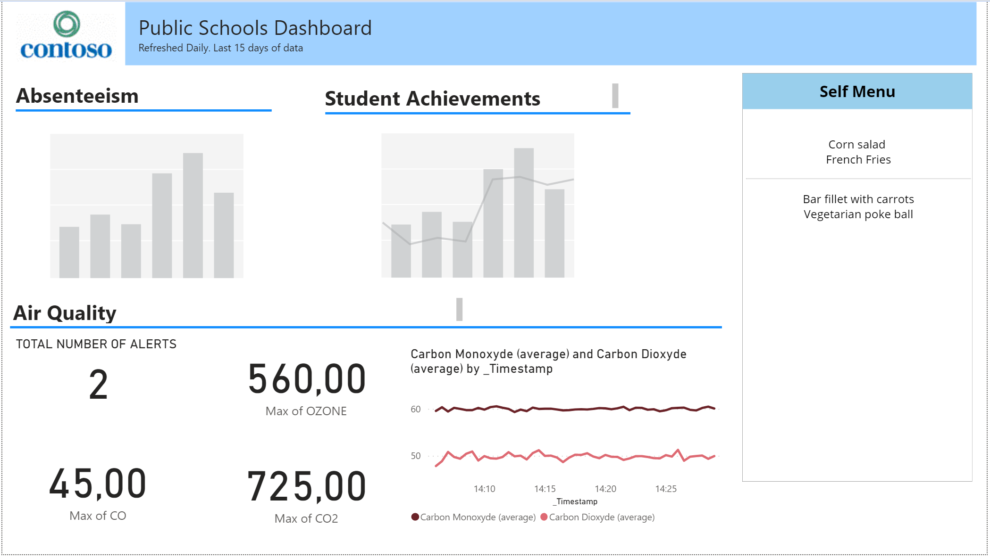
Augment your existing reports with IoT Data
Notes:
Speaker Transcript
One of the most straightforward way to use your IoT Data is by augmenting existing dashboard with them.
There, you can see a Power BI report made by the IT department of Contoso city. On top of several traditional data, you now have at the bottom of the report new data coming directly for an air quality IoT deployment.
Let’s dig into how this report is created.
Speaker Notes
Screenshot
Realtime air quality data from school
Canteen menu for today
Weather forecast for today
Out of school activities
Non-attendance report

Slide 16

Augment your existing reports with IoT Data
Postgresql database
Postgresql database
PowerApps
application
Stream
Analytics
Azure SQL
Time series
insights
Notes:
Speaker Transcript
Existing data comes from operational databases.
The IoT data comes from two distinct data sources. Air quality alerts are stored in an Azure SQL database, from a Stream Analytics Jobs. This job will only output a new line in the Azure SQL Database when one of the sensor value goes above a threshold value. Hopefully, our SQL table will contain very few lines.
The graph at the bottom right is a bit different. It’s a graph of the sensor readings, with an interval of five minutes. Here, all the processing is actually done in Time Series Insights. We’re just exposing this data within Power BI.
Speaker Notes
Screenshot
Realtime air quality data from school
Canteen menu for today
Weather forecast for today
Out of school activities
Non-attendance report

Slide 17
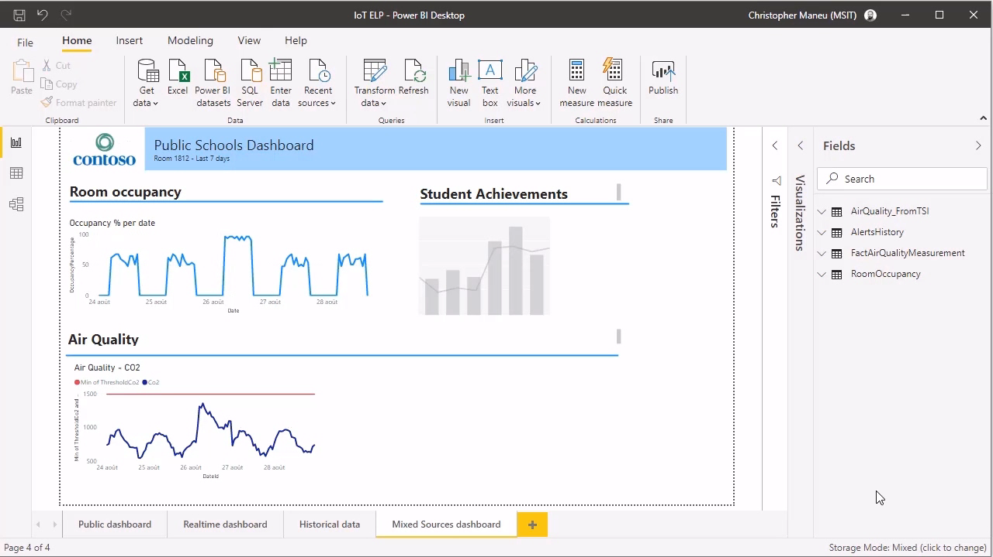
DEMO VIDEO PLACEHOLDER
Notes:
DEMO CONTENTS:
Ingest Data to Data Lake with direct IoT Hub output
Ingest Data into the Datawarehouse (Synapse with a data flow or Azure Stream Analytics ?)

Slide 18
Using IoT as an operational Data Source
Azure Stream Analytics
Azure IoT Hub
Power BI
Azure Data Factory
Azure SQL Datawarehouse
Azure Synapse Analytics
Synapse Analytics
Azure SQL
Azure Data Lake Gen 2
Notes:
Speaker transcript
In this architecture, all our reporting is based on structured data, ingested all day via Azure Stream Analytics.

Slide 19
Using IoT as an operational Data Source
Azure Stream Analytics
Azure IoT Hub
Power BI
Azure Data Factory
Azure SQL Datawarehouse
Azure Synapse Analytics
Synapse Analytics
Azure SQL
Azure Data Lake Gen 2
Notes:
Speaker transcript
In some architecture, we also see this processing happening in batch mode, once a day. You can implement this ETL process with tools like Azure Data Factory or the Data Flow feature of Synapse Analytics.
Data stored within the data lake can be organized. In Big Data Scenarios, you can also use these architecture to refine raw data into a more structure and enriched form also stored in the data lake.

Slide 20
Using IoT as an operational Data Source
Azure Stream Analytics
Azure IoT Hub
Power BI
Azure Data Factory
Azure SQL Datawarehouse
Azure Synapse Analytics
Synapse Analytics
Azure SQL
Azure Data Lake Gen 2
Notes:
You can use Azure Synapse Analytics to process raw data from a Data Lake easily. But it can also be used to store data. In fact, all the demos you’ve seen so far don’t use an Azure SQL Datawarehouse, but are using Synapse Analytics. Using it within your architecture can allows you to reuse your existing datawarehouse skillsets and apply them to a whole lot new level.

Slide 21
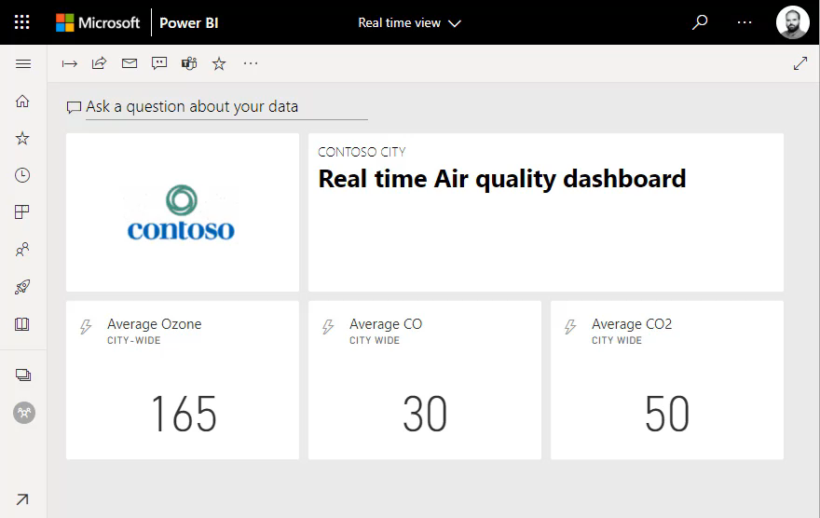
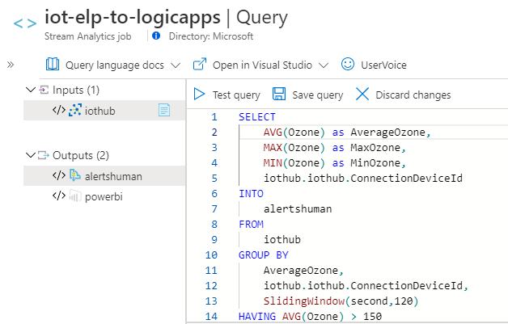
Augment your existing dashboards with realtime IoT Data
Notes:
Speaker Transcript
Data engineers are mostly asked to work on historical data. With Power BI and Azure, they can also easily work on real time analytics.
By using Stream Analytics, you can process, aggregate and filter data coming from IoT Hub in real time and outputting this data to several destinations. For example, you can use the streaming data tile withing an Azure Dashboard to display this data in realtime. No code, no background service, you just have to write a SQL query!
Speaker Notes
Screenshot
Realtime air quality data from school
Canteen menu for today
Weather forecast for today
Out of school activities
Non-attendance report

Slide 22
Using IoT as an operational Data Source
Azure Stream Analytics
Azure IoT Hub
Power BI
Azure Data Factory
Azure SQL Datawarehouse
Azure Synapse Analytics
Synapse Analytics
Azure SQL
Azure Data Lake Gen 2
Notes:
Speaker Transcript
Azure Stream Analytics can process your IoT Data in realtime, both for your analytics store but also for realtime dashboard needs.

Slide 23
Demo: Identify anomalies by routing data via IoT Hub to a built-in ML model in Azure Stream Analytics
Create an Azure IoT Hub, using the Azure portal
Create an Azure IoT Hub device identity, using the Azure portal
Create a C# app to send device telemetry to the IoT Hub, using Visual Studio or Visual Studio code
Create a message route, through to storage, using the Azure portal
Create a second message route, through to an Azure Analytics job, using the Azure portal
Create a dashboard to visualize data anomalies, using Power BI
Azure IoT Hub
Azure Stream Analytics
Power BI
Notes:
Speaker transcript
We just saw that integrating IoT data into your Data Analytics landscape is possible. Now, let’s see some concrete examples on hot to get insights and actions from your IoT Data.

Slide 24
Realtime actions with Logic App
Notes:
Speaker Transcript
In this demo, we’ll see how to start real time actions with Azure Stream Analytics and Logic App

Slide 25
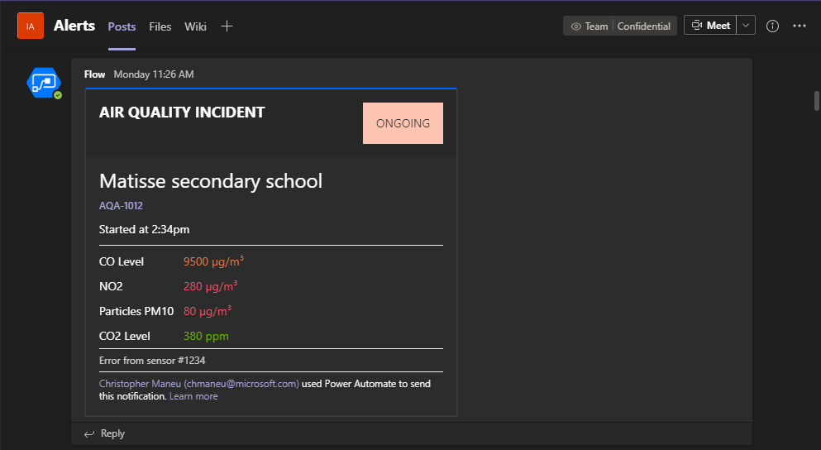
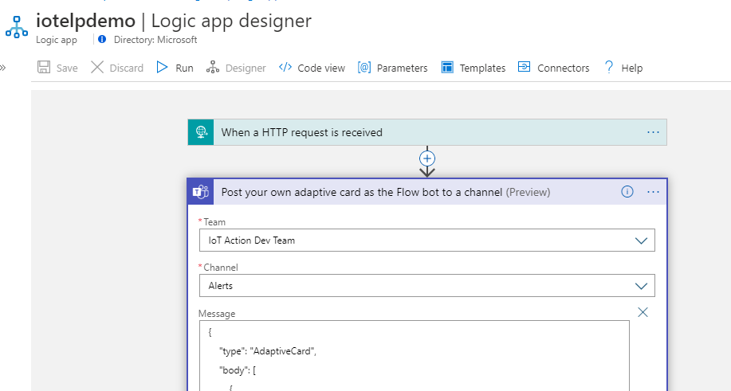
IoT empowers immediate action
Notes:
Speaker Transcript
But why limiting yourself to crunching and displaying data? When you know how to use Stream Analytics, you’re a step away from executing your or code, or better, a workflow. Here, the same Azure Stream Analytics Job is also launching the execution of an Azure Logic App – a no-code, serverless workflow service in Azure – allowing me to execute actions in a wide range of applications, like sending a message in a specific channel in Teams.
Speaker Notes

Slide 26
Using IoT as an operational Data Source
Business services
Azure Stream Analytics
Teams
Event Hubs
Logic App
Azure IoT Hub
Time Series Insights
Power BI
Azure Data Factory
Azure SQL Datawarehouse
Azure Synapse Analytics
Synapse Analytics
Azure SQL
Azure Data Lake Gen 2
Notes:
Speaker Transcript
We now have.

Slide 27
Going further with IoT Edge and SQL Edge
IoT Device
Azure Stream Analytics
Edge Stream Analytics
Azure IoT Hub
Time Series Insights
Azure SQL Edge
Azure Data Factory
Azure SQL Datawarehouse
Azure Synapse Analytics
Synapse Analytics
Azure SQL
Azure Data Lake Gen 2
Notes:
Speaker Transcript
Todo

Slide 28
Time Series Insights Collect, store, model and visualize timeseries and historical data

Slide 29
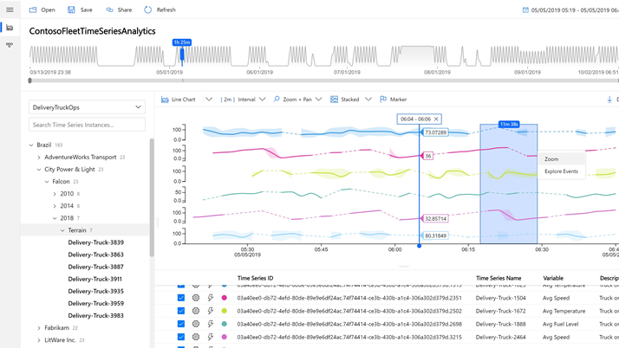

Azure Time Series Insights (TSI)
A serverless, fully-managed Platform as a Service (PaaS) solution built for IoT
Ingest, process, store, and query highly contextualized, time-series-optimized, IoT-scale data
Built-in rich user experience for ad-hoc queries and exploration
Rich analytics APIs for ad-hoc exploration and operational intelligence
JavaScript control library for building custom analytics apps on the TSI platform
Notes:
Session 4: Understand IoT message processing, analytics, and business integration
Azure Time Series Insights (TSI) is a serverless, fully-managed Platform as a Service (PaaS) solution built for IoT. Features include the following:
Highly contextualized, time-series-optimized, IoT-scale data that can be Ingested, processed, stored, and queryed
Built-in rich User Experience for ad-hoc queries and exploration
Rich analytics APIs for ad-hoc exploration and operational intelligence
A JavaScript control library for building custom analytics apps on the TSI platform
Remember that option 1 path with building with our platform services?

Slide 30
Turn insight into action with an end-to-end analytics platform
Collect
Store
Model
Analyze
Connect your industrial assets with instant data ingestion and no extra coding or data preparation
Store your data across warm and cold storages so you can instantly access to streaming and historical IoT data
Contextualize your data with nesting menus showing hierarchies, relationships and properties to get a clearer picture of your operations
Analyze your data with a turnkey experience of rich graphic visualizations and tools to help you go deep into your IoT data
Notes:
Azure Time Series Insights is the only product providing an end-to-end solution to collect, store, model and visualize timeseries and historical data with no upfront data preparation.
Collect: Your assets—such as sensors, equipment, and buildings—are constantly streaming new information. Easily ingest all your IoT data into Time Series Insights—you don’t have to write a single line of code, saving you valuable time and resources. And as your business grows, you can scale on-demand so you’re prepared for all that the future holds.
Store: As your IoT engagement grows, so does the amount of data you need to store. Multilayered storage lets you amass data across warm and cold storages while enabling instant access to streaming and historical IoT data.
Model: In order to make sense of it all, your data needs context. Azure Time Series Insights provides robust modelling capabilities to form a clearer picture of your operations. By establishing hierarchies and relationships between data sets, you can do things like understand variables in your production line or find the cause behind a defective product.
Analyze: Tell your data story with the right visualizations. The Azure Time Series Insights explorer provides a turnkey experience including rich graphic visualizations and tools to conduct deep analysis into your IoT data. You can explore and monitor, perform operational analysis, and even apply models for machine learning inference and predictions.
Transition: Let’s take a close look at how it all works: (click)

Slide 31

Azure Time Series Insights pay as you go high level architecture
Collect
Historical data
Azure Event
Hub
Azure IOT
Hub
Azure Digital Twins
Timeseries data
API requests/returns
AI/ML workflow
Notes:
COLLECT
Whether you have a couple of sensors or hundreds of thousands of them, they are constantly generating timeseries data – commonly called telemetry. Collecting all this data is the first step to unlocking its potential.
Depending on the types of data you are collecting and how you plan on using it, Time Series Insights leverages 4 different ingestion methods. Bring your historical data from your on-premises storage or historian and upload it directly to Time Series Insights. If you have unmodeled timeseries data, utilize Azure Event Hub for ingestion. Azure IoT Hub is best for device telemetry, and for your logical twin telemetry, Azure Digital Twins is the way to go.
No matter how you collect your data, Time Series Insights makes it seamless to ingest without having to write any upfront code, saving you valuable time and resources.
Transition: Next, your data needs processing. (click)

Slide 32

Azure Time Series Insights pay as you go high level architecture
Collect
Historical data
Real Time Processing engine
Azure Event
Hub
Azure IOT
Hub
Azure Digital Twins
Stream processing
engine
Timeseries data
API requests/returns
AI/ML workflow
Notes:
As your data is being collected, it is normalized through the Stream Processing engine before being sent to storage. Along with the Stream Processing Engine, Time Series Insights also provides a powerful calculation engine to add conditional logic, derived timeseries, or the ability to recall last known value as part of the normalization process. This data is then returned to the Stream Processing Engine to be placed into either warm or cold storage.
Transition: So where do keep all this data? (click)

Slide 33

Azure Time Series Insights pay as you go high level architecture
Collect
Store
Calculation engine
COLD STORE ADLS Gen 2/ Azure Blog
Azure Event
Hub
Azure IOT
Hub
Azure Digital Twins
Stream processing
engine
WARM STORE
Timeseries data
API requests/returns
AI/ML workflow
Notes:
STORE
Of course, now that you have all this data collected, you need somewhere to store it. Time Series Insights’ multilayered storage lets you amass data across warm and cold storages while enabling instant access to streaming and historical IoT data.
As your IoT operations grow, Time Series Insights gives you the flexibility to scale your storage needs on-demand. It’s easy to bring your own Azure Blob or ADLS Gen 2 storage or create new storage when you set up Time Series Insights. Either way, the data is yours and can be accessed by other analytics solutions.
Transition: Your data has been collected and stored. How to you make sense of it? (click)

Slide 34
Azure Time Series Insights pay as you go high level architecture
Collect
Store
Model
Real Time Processing engine
COLD STORE ADLS Gen 2/ Azure Blob
Azure Event
Hub
TIME SERIES MODEL
Azure IOT
Hub
Azure Digital Twins
Stream processing
engine
WARM STORE
Timeseries data
API requests/returns
AI/ML workflow
Notes:
MODEL
Traditionally, the data that's collected from your IoT devices lacks contextual information, which makes it difficult to find and analyze sensors quickly. The main motivation for Time Series Model is to simplify finding and analyzing IoT data. It achieves this objective by enabling the curation, maintenance, and enrichment of time series data to help prepare consumer-ready datasets for analytics.
The modeling itself happens at several stages in the process. It is layered over the Stream Processing Engine, calculation engine and storage options, allowing you to contextualize your data by types, relationships and hierarchies. Over time, the model continually optimizes this data for higher performance queries.
Transition: Now let’s take a look at how you visualize all this data. (click)

Slide 35
Azure Time Series Insights pay as you go high level architecture
Collect
Store
Model
Analyze
Real Time Processing engine
</>
COLD STORE ADLS Gen 2/ Azure Blob
Azure Event
Hub
TIME SERIES MODEL
Time Series Query API
TIME SERIES INSIGHTS EXPLORER
POWER BI CONNECTOR
3rd PARTY APPS
Azure IOT
Hub
Azure Digital Twins
Stream processing
engine
WARM STORE
Timeseries data
API requests/returns
AI/ML workflow
Notes:
ANALYZE
Then, tell your data’s story with rich visualizations via a turnkey experience via the Time Series Insights Explorer. Or, use Time Series Insights’ open APIs and toolkits to connect 3rd party applications for visualizations across devices. Time Series Insights even connects natively to Power BI for a complete picture of your IoT infrastructure.
These interfaces connect to your data through the Time Series Query API which allows you to perform interactive queries to retrieve data from warm storage, cold storage or both. The Time Series Model adds further contextualization when the API call is returned.
Transition: But, there’s more to gain from Time Series Insights. (click)

Slide 36
Azure Time Series Insights pay as you go high level architecture
Collect
Store
Model
Analyze
Real Time Processing engine
</>
COLD STORE ADLS Gen 2/ Azure Blob
Azure Event
Hub
TIME SERIES MODEL
Time Series Query API
TIME SERIES INSIGHTS EXPLORER
POWER BI CONNECTOR
3rd PARTY APPS
Azure IOT
Hub
Azure Digital Twins
Stream processing
engine
WARM STORE
</>
TSM Update API
Timeseries data
API requests/returns
AI/ML workflow
Notes:
Once Time Series Insights is up and running, new data is synced continuously via the TSM Update API, providing you near real-time visualizations of your streaming data. You can also send logical twin models and device twin models directly to the TSM Update API for seamless integration into the Time Series Model.
Transition: Does Time Series Insights support AI and machine learning? (click)

Slide 37
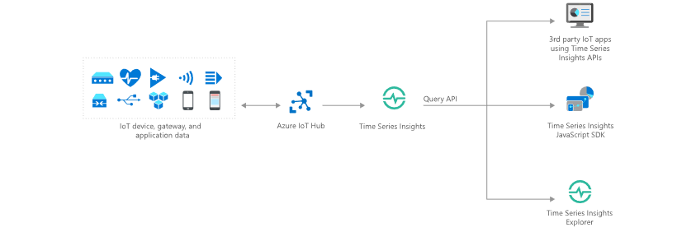
Data exploration and anomaly detection
Uncovering the Why
Anomaly detection and diagnosis
Examples:
Understanding why equipment requires extra maintenance.
Searching why inventory was damaged.
Researching why production declined on an assembly line.
Chasing down a defect in the supply chain process.
Notes:
We showed you one common use case for Time Series Insights- It’s all about uncovering Why something happened. What was different this time that produced another result.
TSI is primed for these use cases because:
No upfront data preparation needed
Connect to billions of events in Azure IoT Hub or Azure Event Hub, and visualize & analyze billions of events to spot anomalies and discover hidden trends in your data
Simple and easy to use exploration experience, while at the same time providing granular text-based querying for advanced users who are familiar with SQL
Perform DevOps analysis to get to the root cause of a bug in an IoT solution or identify areas to investigate for data science initiatives
INSERT CUSTOMER STORY/ EXAMPLE

Slide 38
Demo: Time Series Insights Walkthrough
Notes:
Product Demo using the Business Scenario: https://insights.timeseries.azure.com/demo

Slide 39
Resources
Notes:
ELP videos/presentation decks, MS Learn and Learn Paths, Instructor Led Training options, AZ220 Study Guide blog, IoT Demo GitHub and ultimately encouraging people to sign up for the 30 Days to Learn it challenge to earn 50% off the certification.

Slide 40
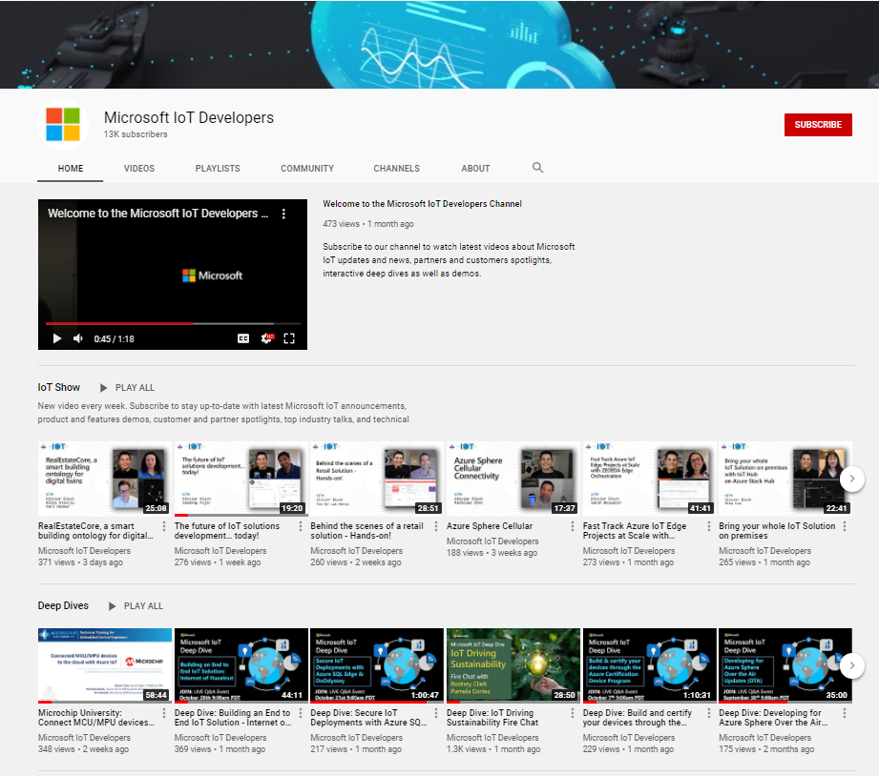
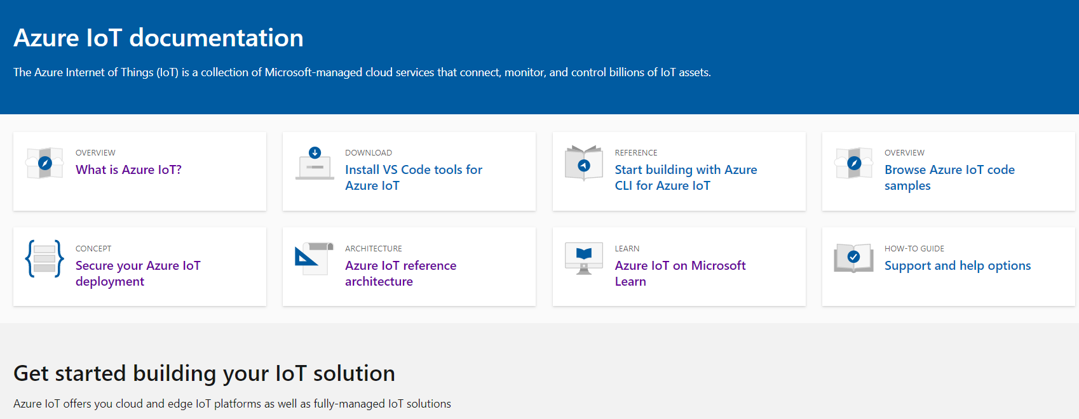
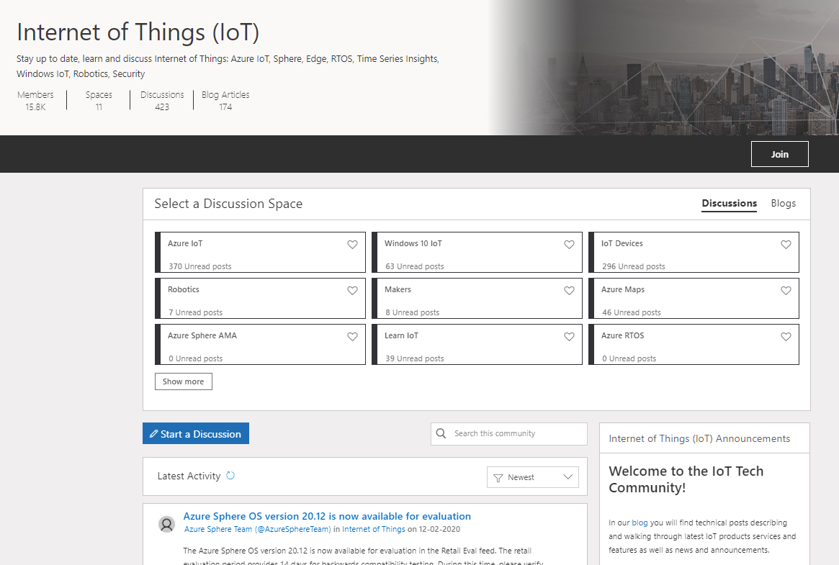
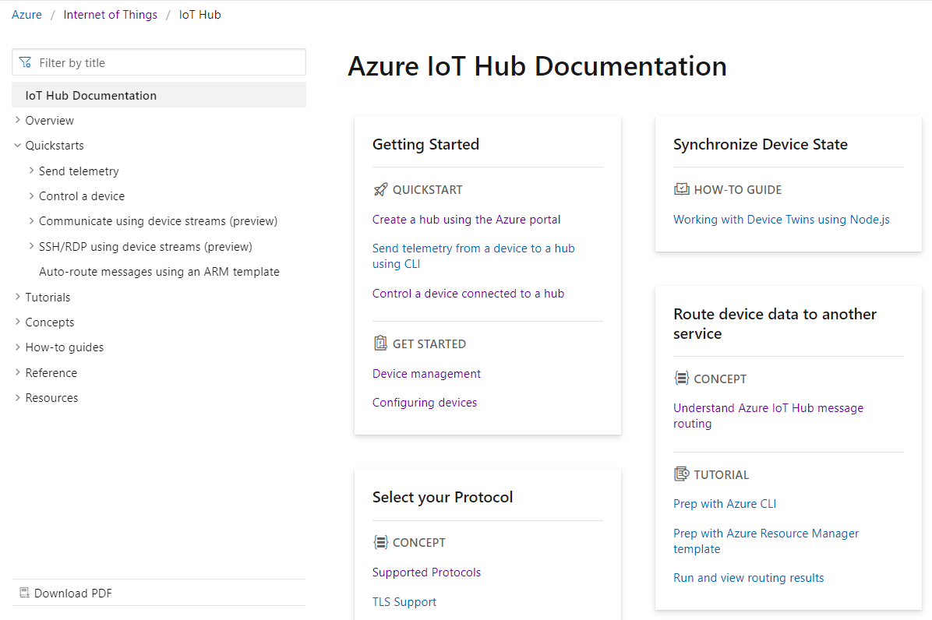

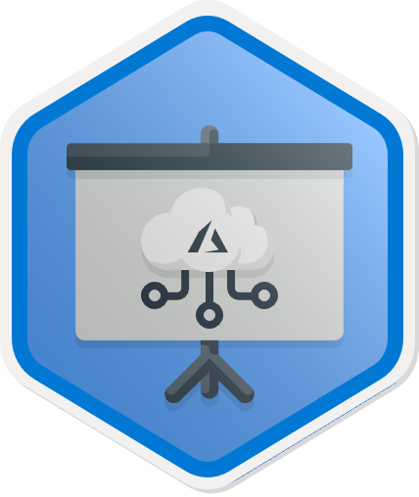
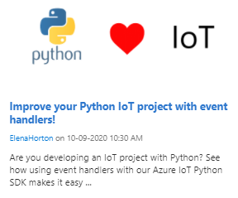
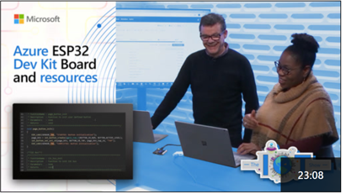
https://aka.ms/get-started-azure-2021
Start upskilling on Azure IoT today!
Hands on Learning | Watch | Discover and Discuss | Get Started Building
Microsoft Learn | Microsoft IoT Developers Channel | IoT Tech Community | Azure IoT Docs
https://aka.ms/mslearniot | https://aka.ms/msiotdevs | https://aka.ms/iottechcommunity | https://docs.microsoft.com/en-us/azure/iot-fundamentals/
MS Learn is the go-to site for self-paced, step-by-step learning. We offer over 40+ individual learn modules covering products such as Azure IoT Hub, IoT Edge, Digital Twins, and more. | Watch and learn about our products! View Deep Dives for deep technical learning. | Check out the blog to find technical posts describing and walking through latest IoT products services and features as well as news and announcements. | Check out the quick starts, how-to guides, and tutorials on Azure IoT Docs to learn how to build your IoT solutions.
https://aka.ms/IntroAzureIoTLearningPath
Notes:
Additionally, MS Learn offers 8 Learning Paths designed to help with certification exam prep as well as deeper concepts targeted at different roles including IoT developer, data engineer, solution architect, and administrator.
ELP videos/presentation decks, MS Learn and Learn Paths, Instructor Led Training options, AZ220 Study Guide blog, IoT Demo GitHub and ultimately encouraging people to sign up for the 30 Days to Learn it challenge to earn 50% off the certification.
Aka.ms/30dayscsc

Slide 41

30 Days to Learn Cloud Skills Challenge
’30 Days to Learn it’ offers a time-bound, personalized, Cloud Skills Challenge that is built upon Microsoft Learn. It is designed to help developers build in-demand skills that advance their career, while preparing them to earn the Microsoft Certification for the Azure IoT Developer (AZ220) exam.
https://aka.ms/30DaysCSC/IoT
Notes:
ELP videos/presentation decks, MS Learn and Learn Paths, Instructor Led Training options, AZ220 Study Guide blog, IoT Demo GitHub and ultimately encouraging people to sign up for the 30 Days to Learn it challenge to earn 50% off the certification.
Aka.ms/30dayscsc

Slide 42
Live Q&A Thank you! IoT Arch Reference: https://aka.ms/iotrefarchitecture Azure Account Signup: https://aka.ms/get-started-azure-2021 Azure IoT Central: https://apps.azureiotcentral.com/myapps Cloud Skills Challenge: https://aka.ms/30DaysCSC/IoT MS Learn: https://aka.ms/mslearniot MSFT IoT Developer Video Channel: https://aka.ms/msiotdevs IoT Tech Community: https://aka.ms/iottechcommunity Azure IoT Docs: https://docs.microsoft.com/en-us/azure/iot-fundamentals/
Notes:
ELP videos/presentation decks, MS Learn and Learn Paths, Instructor Led Training options, AZ220 Study Guide blog, IoT Demo GitHub and ultimately encouraging people to sign up for the 30 Days to Learn it challenge to earn 50% off the certification.

Slide 43
We would love to hear from you! Would you please tell the Azure IoT engineering team about your development processes and tools? By completing this very short (<4 minute) survey? http://aka.ms/EmbeddedDevResearch
Notes:
ELP videos/presentation decks, MS Learn and Learn Paths, Instructor Led Training options, AZ220 Study Guide blog, IoT Demo GitHub and ultimately encouraging people to sign up for the 30 Days to Learn it challenge to earn 50% off the certification.

Slide 44


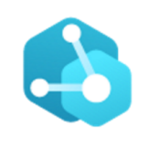
Develop with choice
Digital Twins
Azure IoT Central
Azure IoT Hub
The easiest and most cost-effective way to connect and manage devices at scale, and time to results.
Enable highly secure, flexible and reliable communication from the cloud to the edge.
Create comprehensive digital models of entire environments.³
1000+ Azure IoT Devices certified¹
150 billion messages per month via IoT Hub²
Gartner includes Microsoft as a Digital-Twin-Enabled Application Provider³
1 Placeholder Source; 2 Placeholder Source; 3 Gartner: Market Guide for Digital Twin Portfolios and Enabling Technologies (Jan 2020)
Notes:
Azure IoT Central is the easiest and most cost-effective way to connect and manage devices at scale. It connects your IoT devices to the cloud faster than any other platform. You can find new devices matched to your solution in the Azure Certified for IoT device catalog. Also, we understand how hard it is to keep devices connected and healthy. Azure IoT Central lets you reconfigure and update devices with centralized device management. In addition, the connectors and extensibility APIs bridge the gap between your business applications and IoT solution.
Azure IoT Hub is a Platform as a Service. With it you can do the following:
Establish bi-directional communication with billions of IoT devices
Enhance security with per device authentication
Provision devices at scale with IoT Hub Device Provisioning Service
Manage devices at scale with device management
Use multi-language and open source SDKs
A Digital Twin (DT) is a dynamic digital representation of a physical piece of equipment, or thing, and its associated environment. Every DT has a dynamic data model containing only a few, or even thousands, of data attributes of the physical thing or system it represents. Attributes are associated with sensors that are measuring temperature, pressure, and other variables and associated physics in order to represent real-world operating conditions as well as static values like the installation date or OEM. Azure Digital Twins is the development platform for IoT solutions that model the real world.

Slide 45


IoT Hub and Device Provisioning Service
Device Provisioning Service
Azure IoT Hub
Bi-directional communication
Enterprise scale & integration
End-to-end security
IoT-scale automated provisioning
Millions of Devices
Multi-language, open source SDKs
HTTPS/AMQPS/MQTTS
Send Telemetry
Receive Commands
Device Management
Device Twins
Queries & Jobs
Billions of messages
Scale up and down
Declarative Message Routes
File Upload
WebSockets & Multiplexing
Azure Monitor
Azure Resource Health
Configuration Management
Per Device Certificates
Per Device Enable/Disable
TLS Security
X.509 Support
IP Whitelisting/Blacklisting
Shared Access Polices
Firmware/Software Updates
Azure Defender Support
Zero-touch provisioning
Centralize your provisioning workflow
Load balance across multiple IoT Hubs
Re-provisioning support
Supports TPM + X.509
Notes:
Per device authentication

Slide 46
Biggest challenges with devices
Open source SDKs
IoT Hub
Device Provisioning Service
Developing and maintaining a connected,
secure, serviceable and supportable device
Integrating devices and their data into cloud services
Out-of-the-box provisioning of devices at scale
But what about device management over the long-term?

Slide 47
IoT Device Management Lifecycle
Replace or decommission devices after failure, upgrade cycle or service lifetime
Group devices and control access according to your organization's needs
Retire
Plan
Monitor device inventory, health and security while providing proactive remediation of issues
Securely authenticate devices, on-board for management and provision for service
Monitor
Provision
Configure
Provide updates, configuration and applications to assign the purpose of each device

Slide 48
Why provisioning is hard today?
Solutions must have per-device revocable access
Provisioning is a manual process
Initial configuration can become irrelevant between manufacturing and deployment
Device supply chains are complex

Slide 49
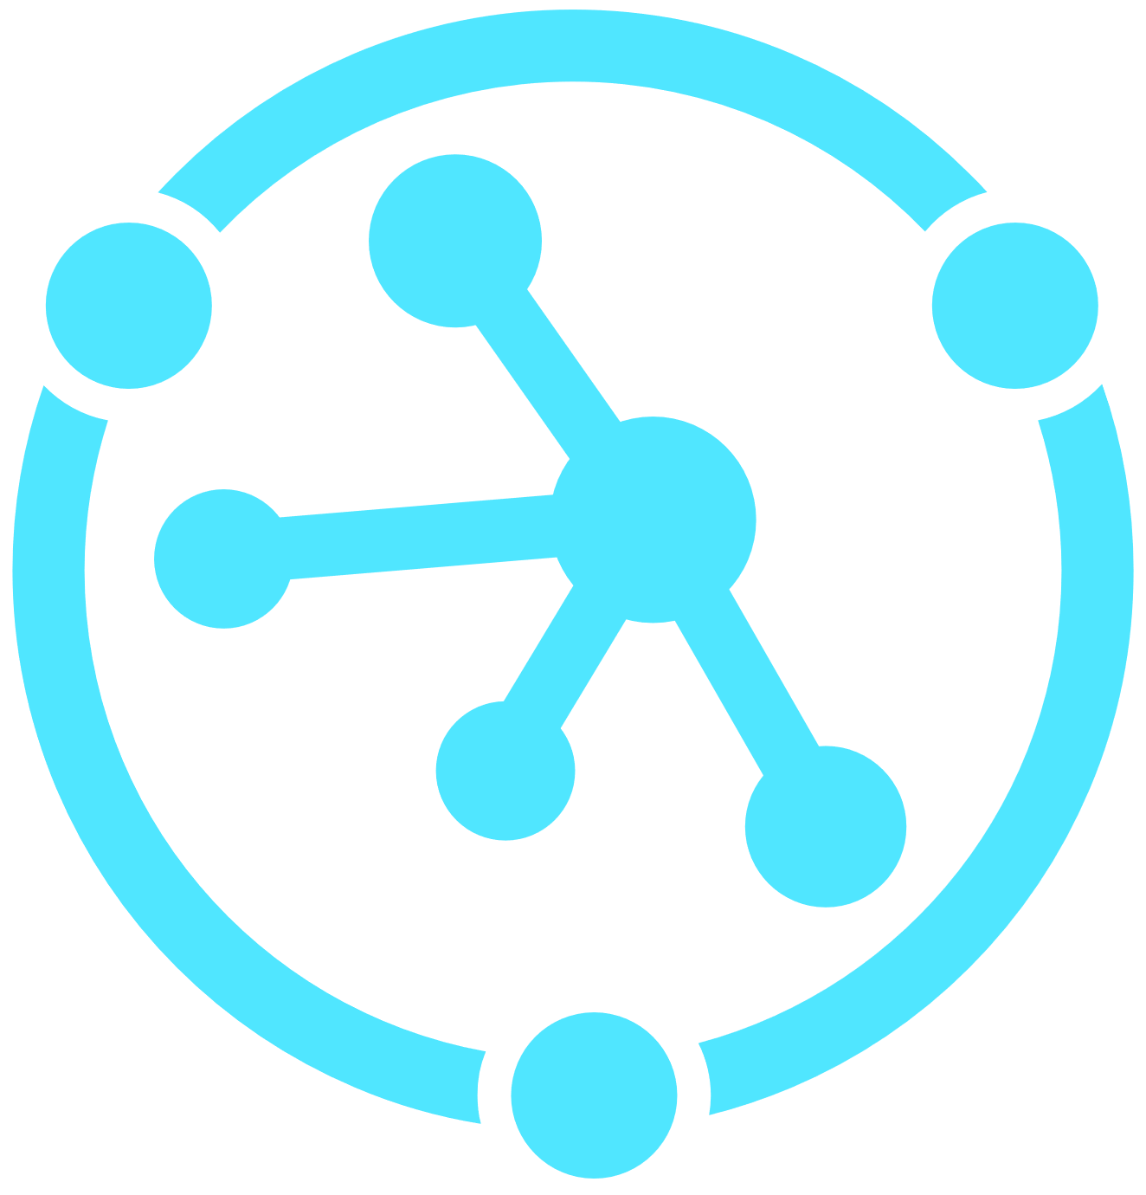
Device Provisioning Service (DPS) brief feature overview
Cross-region, cross-subscription DPS→IoT Hub support for geo-sharded and multitenancy solutions
Automatic re-provisioning supports the device lifecycle
Factory reset
Migration
Flexible, targeted device assignment logic
Static assignment for when you know the hub
Evenly weighted for round-robin assignment
Lowest-latency for geo-shared applications
Custom assignment logic for advanced scenarios
Manage devices at as a group or as individuals
Based on authentication type
Multiple auth methods supported
Symmetric keys for getting started
TPM endorsement key for secure storage
X.509 certificates for maximum security
Cross-platform support through open-source SDKs
Edge device support
Notes:
Secure attestation support for both X.509 and TPM-based identities.
Enrollment list containing the complete record of devices/groups of devices that may at some point register. The enrollment list contains information about the desired configuration of the device once it registers, and it can be updated at any time.
Multiple allocation policies to control how DPS assigns devices to IoT hubs in support of your scenarios: Lowest latency, evenly weighted distribution (default), and static configuration via the enrollment list. Latency is determined using the same method as Traffic Manager.
Monitoring and diagnostics logging to make sure everything is working properly.
Multi-hub support allows DPS to assign devices to more than one IoT hub. DPS can talk to hubs across multiple Azure subscriptions.
Cross-region support allows DPS to assign devices to IoT hubs in other regions.
Encryption for data at rest allows data in DPS to be encrypted and decrypted transparently using 256-bit AES encryption, one of the strongest block ciphers available, and is FIPS 140-2 compliant.
Lowest latency: This policy assigns devices to the linked IoT Hub which will result in the lowest latency communications between device and IoT Hub.
Evenly weighted distribution: This policy evenly distributes devices across the linked IoT Hubs. If you are provisioning devices to only one IoT Hub, we recommend this setting. The default setting.
Static configuration: This policy requires a desired IoT Hub be listed in the enrollment entry for a device to be provisioned.
Cross platform:
Just like all Azure IoT services, DPS works cross-platform with a variety of operating systems. Azure offers open-source SDKs in a variety of languages to facilitate connecting devices and managing the service. DPS supports the following protocols for connecting devices:
HTTPS
AMQP
AMQP over web sockets
MQTT
MQTT over web sockets
DPS only supports HTTPS connections for service operations.

Slide 50
A Selection of Scenarios
Initial connection
Load balancing
Ownership based
Location based
Re-provisioning
Zero-touch provisioning to a single IoT solution
Across multiple hubs
Connecting devices to their owner’s IoT solution based on sales transaction data
Connecting a device to the IoT hub with the lowest latency
Based on a change in the device, e.g. change of ownership
Notes:
There are many more scenarios the DPS supports than what’s listed on this slide, but this list should give you a taste for the variety of scenarios the DPS can be used for.
First bootstrapping devices to IoT Hub in a single IoT solution is definitely a scenario the DPS can be used for.
Load balancing is one of the simplest multi-hub scenarios to think about. Devices are allocated to different hubs to make management easier.
Ownership based: multitenancy solutions. If you sell widgets to multiple customers, you want to have data isolation. Want to make sure the devices are connected to the hub for the customer who purchased them.
Geolocation based: AKA geosharding. Want the device to connect to the IoT solution geographically closest to it.
Re-provisioning: one of the most important scenarios, and one that happens later in the device’s lifecycle. Re-provisioning could occur because the device was sold to another user, for example in the case of the lease. The device might have moved because it’s a vehicle and now needs to connect to a different region. Or, and this gets back to the security aspect, maybe the device is installed in a sensitive location and policy dictates that the device needs to re-attest (re-delare) its identity every 90 days, or 30 days, or even daily.

Slide 51


What is Provisioning?
Provisioning Setup = Pre-registration + Device Assignment
Device Provisioning = Runtime assignment + Initial Set up
Notes:
Let’s jump into how to Provision millions of devices using DPS.
What does “provisioning.” mean? In general, provisioning devices is a two part process. The first part is called a provisioning set up which requires a human operator to pre-register the device in the IoT solution so the IoT solution knows that the device exists. In addition, the human operator can also add some initial configuration for the devices. The human operator also need to program the device to its target IoT solution.
The second part when the device turns on (For example when a device is connected to wifi) and establishes a connection to the IoT solution where the device need to prove it is indeed the device the human operator has registered previously. Once the device is authenticated, it can go through some runtime assignments as well as gather some set up process.
Only when both of these steps are complete, then the device has been fully provisioned.
Manufacturing step
This step is all about what happens on the manufacturing line. The roles involved in this step include silicon designer, silicon manufacturer, integrator and/or the end manufacturer of the device. This step is concerned with creating the hardware itself.
DPS does not introduce a new step in the manufacturing process; rather, it ties into the existing step that installs the initial software and (ideally) the HSM on the device. Instead of creating a device ID in this step, the device is programmed with the provisioning service information, enabling it to call the provisioning service to get its connection info/IoT solution assignment when it is switched on.
Also in this step, the manufacturer supplies the device deployer/operator with identifying key information. Supplying that information could be as simple as confirming that all devices have an X.509 certificate generated from a signing certificate provided by the device deployer/operator, or as complicated as extracting the public portion of a TPM endorsement key from each TPM device. These services are offered by many silicon manufacturers today.
Cloud setup step
This step is about configuring the cloud for proper automatic provisioning. Generally there are two types of users involved in the cloud setup step: someone who knows how devices need to be initially set up (a device operator), and someone else who knows how devices are to be split among the IoT hubs (a solution operator).
There is a one-time initial setup of the provisioning that must occur, which is usually handled by the solution operator. Once the provisioning service is configured, it does not have to be modified unless the use case changes.
After the service has been configured for automatic provisioning, it must be prepared to enroll devices. This step is done by the device operator, who knows the desired configuration of the device(s) and is in charge of making sure the provisioning service can properly attest to the device's identity when it comes looking for its IoT hub. The device operator takes the identifying key information from the manufacturer and adds it to the enrollment list. There can be subsequent updates to the enrollment list as new entries are added or existing entries are updated with the latest information about the devices.

Slide 52

Provision Challenges
Connection String 3
Connection String 1
Connection String 2
IoT Devices
IoT Hub
Notes:
The process in the example is relatively simple and you can easily automate it all through scripts. However what if you expand the scope a little bit?
What if you have multiple IoT Devices that you want to assign to an IoT Solution? You would need to assign each individual devices the IoT Hub Connection String. This is also relatively easy when you have one IoT Hub as you can add this information into the device at the time of manufacturing.
Expanding a little more, you want to add new IoT Devices to a new IoT Hub, it’s getting harder because you need to keep track of multiple devices and IoT hubs and where they are assigned.
Finally, what if you want to assign an existing device to a new IoT Hub, this is especially difficult because the human operator would have to program the device because each IoT Hub has a unique endpoint. This last example is also not always feasible because IoT devices may be already be deployed and installed and reconfiguration is very difficult
To summarize, provisioning can be a very tedious and manual process as you add new devices or expand your iot backend. And initial device assignment may need to change once the device has successfully provisioned.

Slide 53

IoT Hub Device Provisioning Service
A helper service for IoT Hub that enables zero-touch, just-in-time provisioning to the right IoT hub without requiring human intervention.
IoT Devices
IoT Hub Device Provisioning Service
IoT Hub
Notes:
To mitigate some of the challenges mentioned, IoT Hub Device Provisioning Service that can simplify the provisioning setup and also allow for late assignment of IoT Devices to IoT hubs
after the device is connected

Slide 54
Provisioning with IoT Hub Device Provisioning Service
Pre-register device enrollment info
IoT Hub
Register new device, populate initial config
IoT Hub
Device Provisioning Service
IoT Hub Connection String
IoT Hub
IoT Hub
Business logic
IoT Hub Connection String
Device authentication
IoT Hub
Device telemetry
“where do I go”
Device telemetry
Establish connection
Device
Initial configuration
…etc
Insights
Notes:
Let’s go over how provisioning works with a device provisions via IoT Hub Device Provisioning Service . Only one IoT hub will shown for clarity, but the process works with up to 10 hubs linked to a single DPS
[each numbered point is a literal click stop]
After the device is manufactured, the device enrollment information is added to the DPS. This is the only manual step in the process as part of the provisioning set-up
At some point afterwards, which could be a day or it could be several months, the device goes online and connects to DPS to find its IoT solution home.
DPS and the device go through an authentication handshake using the device identity info. DPS verifies the device’s identity
DPS registers the device to IoT hub and populates the initial desired device state
IoT hub returns IH connection info for the device
DPS gives the device its IoT Hub connection info
The device now establishes a connection with IoT hub…
…and retrieves its initial config from IoT hub and makes any changes/updates, as needed
The device starts sending telemetry to IoT hub
The telemetry is consumed by the backend business logic
The business logic produces insights which are transformed into commands to the device to operate more efficiently
The telemetry/insights loop continues for the rest of the device’s useful life

Slide 55
Re-Provisioning at Scale
IoT Hub
East US
Device
Provisioning request
Devices assigned to IoT Hub East US
Change devices assignments to IoT Hub West US
Device
IoT Hub
West US
Device
IoT Hub
East Europe
Device
Device
IoT Hub
West Europe
……millions
Notes:
Millions of device can connect to the global endpoint of the Azure IoT Hub Device Provision Service and be assigned to the correct IoT Hub. But If the devices need to change to another IoT Hub, an example could be when devices are sold to another user and now the devices need to connect to another region. IoT Hub device provisioning service can do all of this with one simple Iot Hub assignement change and allow the devices to sent out a new provision request to fetch the new IoT hub information. This is just a quick demonstration on how re-provisioning works. Devices can reconnect to IoT Hub Device Provisioning Service with a new provisioning request to get reassigned to a new IoT Hub without changing any device code

Slide 56
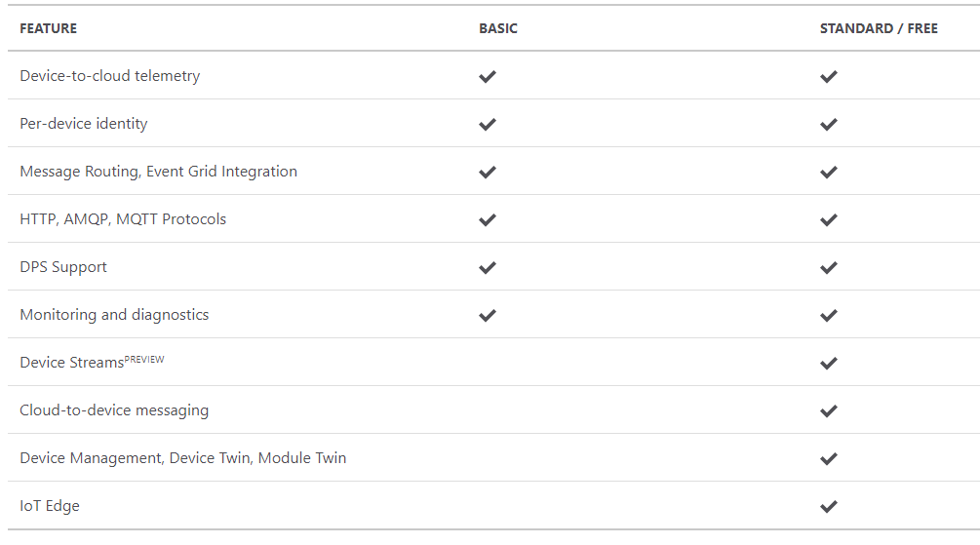
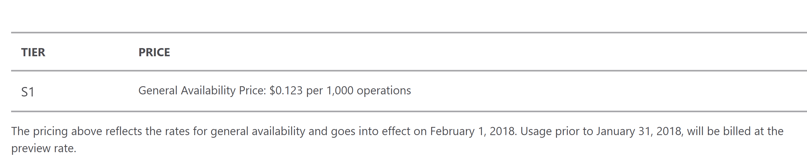
IoT Hub & Device Provisioning Service Support
Azure IoT Hub
Easy upgrade from basic to standard tier.
Only standard allows cloud-to-device commands, device twin operations and IoT Edge
Learn about IoT Hub scaling
Device Provisioning Service
Notes:
Before we jump into the dev tools and the lab, let’s discuss tier
IoT Hub Device Provisioning Service is billed by the number of operations. Operations include device registrations and re-registrations; operations also include service-side changes such as adding enrollment list entries, updating enrollment list entries and get/query operations. Every six months of inactivity on a given enrollment entry will incur a "keep-alive" operation.

Slide 57
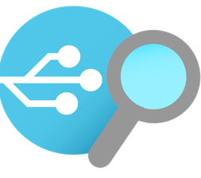
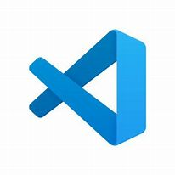
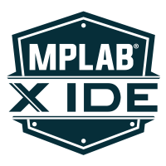
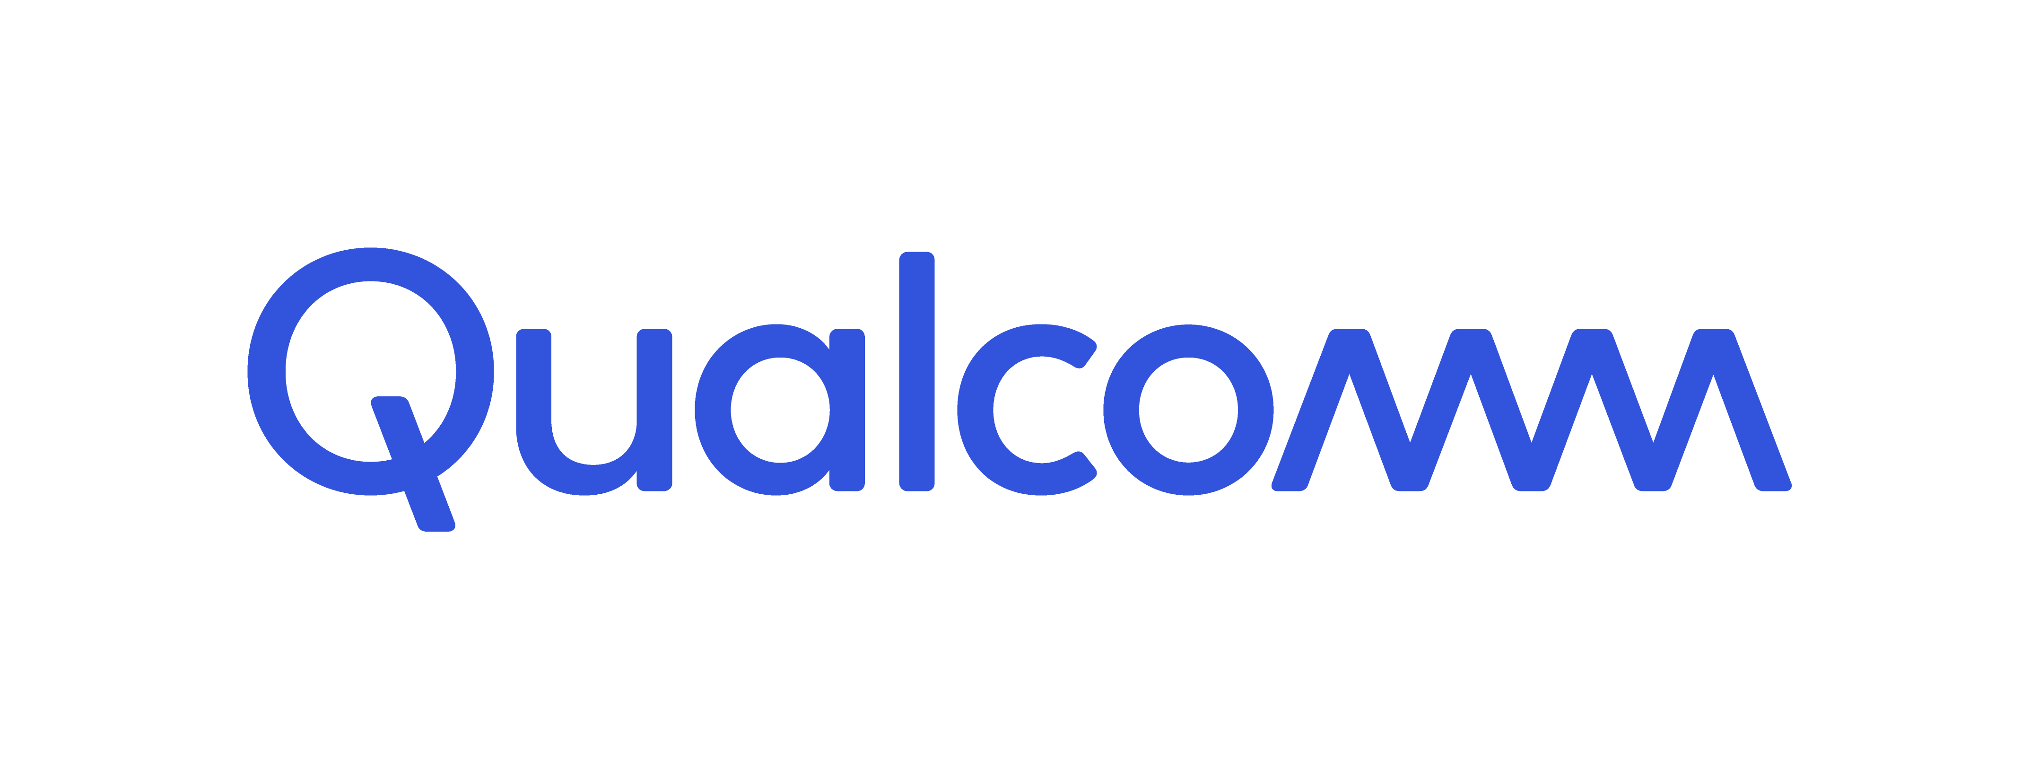



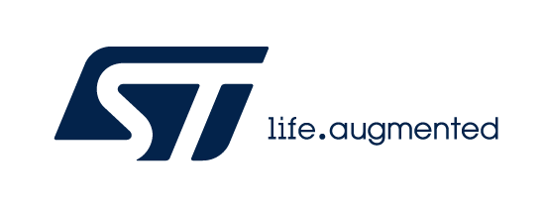
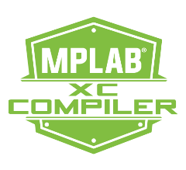
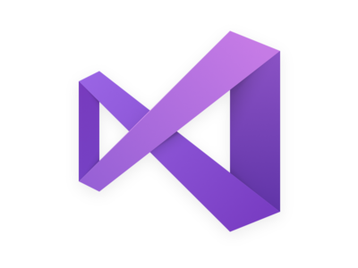

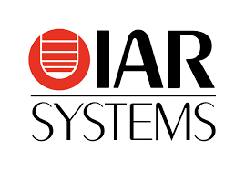
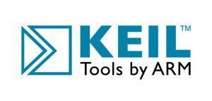





Simplifying IoT with developer tools
Azure IoT Explorer
Graphical tool for interacting with and testing your IoT devices
VS Code
Azure IoT Tools Extension Pack
Visual Studio
Azure IoT Hub & IoT Edge Support
Azure IoT CLI extension
Open-source cross platform command-line tool for managing Azure resources such as IoT Hub
Vendor Tooling
Samples with Azure RTOS, Embedded C SDK, IoT Plug and Play

Slide 58

Demo: Cheese Cave Provisioning devices to monitor and control temperature & humidity
https://aka.ms/get-started-azure-2021
https://aka.ms/get-started-azure-2021
THINGS
INSIGHTS
ACTION
Gain real time insights and improve business processes
Identify patterns in data, automate rules & alerts
Optimize operations, increase profitability, & create more compelling business models
IoT Devices Adding devices to monitor Cheese Caves
across different factories
IoT Hub Device Provisioning Service
IoT Hub
Action
Decision to retire and replace certain devices
Insights
Long term data collected shows device is no longer performing as desired
Notes:
Create DPS resource & group enrollment. Provision device with x.509 certificate attestation
Send Device Telemetry to IoT Hub
Deprovision

Slide 59

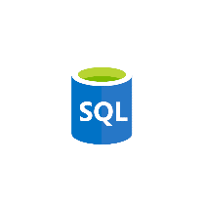


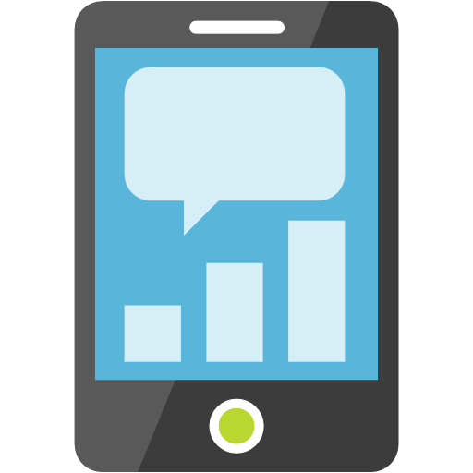








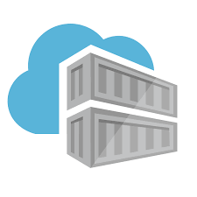







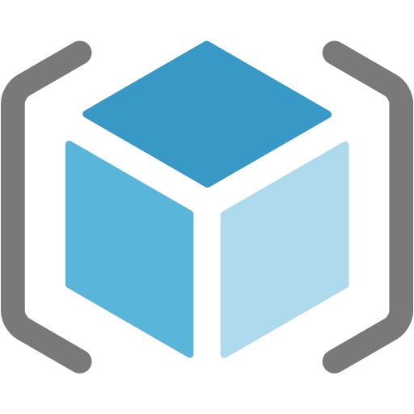


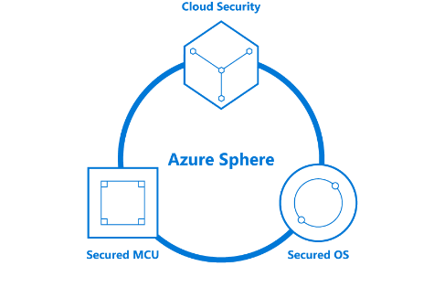
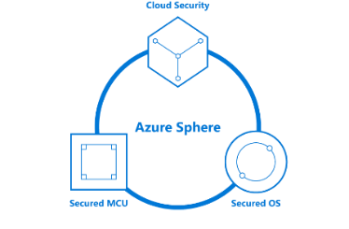
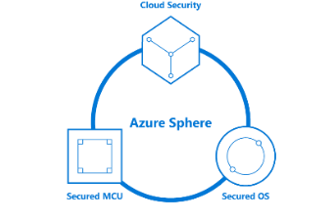




Your options for building IoT solutions
Option 1. Build from the ground up with platform as a service options (Lego blocks)
THINGS
INSIGHTS
ACTION
Gain real time insights and improve business processes
Identify patterns in data, automate rules & alerts
Optimize operations, increase profitability, & create more compelling business models
Manage
View and manage solutions
Azure IoT Device SDK
3rd Party Industry specific sensors & devices
(RTOS, Linux, Windows, Android, iOS)
Functions
SQL Azure
Web Apps
Power BI
Mobile Apps
Edge Modules:
Protocol Adaptation
Functions
Stream Analytics
Machine Learning
AI
Event Hub
Maps
IoT Hub
PowerApps
Web Apps
Azure IoT Edge
Device Provisioning Service
Time Series Insights
Key Vault
Business Integration
Connect to business apps & services
Container
Registry
Azure Stream
Analytics
Cosmos DB
Data Explorer
Application Insights
Dynamics 365
Kubernetes Service
Office 365
Azure Sphere
Compute (VMs)
Content Delivery Network
Storage
Resource Manager (ARM)
3rd Party applications
Domain Name System
Microsoft Flow
Secured MCU
Secured OS
Cloud Security
Service Bus
Front Door
Integrated view for CISO & SecOps personas to review enterprise security posture, including IoT solutions.
Holistic view of IoT solution security posture for DevOps and IoT solution managers to review and manage day to day security status
Azure Defender for IoT
Notes:
Azure IoT Hub and Azure Digital Twins provide the building blocks for companies to construct customized IoT solutions
The right fit for businesses with cloud solution and device expertise (in-house or through partnerships) who want to fine-tune their services with a high degree of control and customization
You can connect devices to IoT Hub
Azure IoT Central enables companies to get started quickly building IoT applications with a fully-managed IoT solution offering.
The right fit for businesses that do not wish to dedicate extensive resources to system architecture and want to select a solution that provides predictable pricing and the ability to customize branding, device types, data management and user roles.
Questions to ask yourself on which choice to take:
1) Expertise: How proficient are you with building cloud solutions
2) Control: What elements of my solution do I want to customize
3) Pricing: What structure best fits your needs?

Slide 60
IoT Solution Architecture
IoT Devices
Custom
Protocols
Custom
Cloud Gateways
UI & reporting Tools
Configure and control
Visualize data and learnings
Constrained Devices
Field Gateways
Constrained Devices
Cloud Gateway (IoT Hub)
Stream Processing
Business Integration
Stream processing and
rules evaluations over data
Edge Devices
Intelligent
Edge
Edge Devices
Data Transformation
Machine Learning
Storage
Cold
Path store
Warm
Path store
IoT Devices
IP Capable devices
send data from devices to Cloud
Store data
Integrate with Business process
Things
Insights
Actions
Notes:
Quick recap from the Deciphering Data Introduction session
Things :
Directly connected, via a gateway, or intelligent edge devices
If you are a device developer you need to be thinking about message types, data types, serialisation, and metadata as these simply data processing in the cloud.
Insights
Stream processing, data transformation, and Storing
Remember to consider the volume and value of data as this will guide you as to where you are storing data
Actions
Integration with business systems
Make better business decision based on data
Opportunities to automate
Batch analytics and training machine learning

Slide 61





IoT Hub Connectivity Models
Direct over WAN
Protocol gateway
Edge
Devices have public IPv4 & connect to IoT hub directly
Direct from a private network
Devices have private IP
Devices’ traffic pass a net. gateway (e.g., HTTP GW) performing NAT
Devices connect to PG
A special-purpose protocol gateway
Edge runtime deploys & manages devices’ code
PG connects to IoT Hub on behalf of devices with their identity
e.g., connected car
e.g., robots in factory floor
e.g., city street lights
Device talks our supported protocols
Indirect through a field gateway
Devices don’t know any of our supported protocols
Devices connect to a field gateway that supports our protocols
e.g., soil moisture sensors on a farm
e.g., deploy image detection for boxes on a conveyor belt
Usually involves high-powered devices
IoT Hub
IoT Hub
IoT Hub
IoT Hub
IoT Hub
BLE/NFC
Edge device
Factory
Edge
FG
GW
PG
Batching &
Proto translation
On-prem
network
Protocol
translation
AI
AI
WAN
Notes:
Devices can connect directly to the Internet
IPv6 is currently not supported on IoT Hub.

Slide 62
Communication protocols
Protocols
IoT Hub is inherently a message-based cloud-hosted service
Supported protocols are AMQP, MQTT and HTTPS
Devices maintain a persisted connection to IoT Hub
Connections are all TLS-enabled and devices are authenticated
Devices have an IoT Hub identity (SAS key or a certificate)
We allow a special-purpose service-identity with higher privileges, e.g.,
Feature | Device-side protocols | Service-side protocols
D2C telemetry messaging | MQTT/WS + AMQP/WS + HTTPS | AMQP/WS + HTTPS
C2D messaging | MQTT/WS + AMQP/WS + HTTPS | AMQP/WS
Direct methods | MQTT/WS + AMQP/WS | HTTPS
Twin operations | MQTT/WS + AMQP/WS | HTTPS
Device streams | MQTT/WS + AMQP/WS (C/C# SDKs) | AMQP/WS (NodeJS/C# SDK)
Notes:
MQTT Version 3.1.1
The following table provides the high-level recommendations for your choice of protocol for device side:
TABLE 1ProtocolWhen you should choose this protocol
MQTT & MQTT over WebSocketUse on all devices that do not require to connect multiple devices (each with its own per-device credentials) over the same TLS connection.
AMQP & AMQP over WebSocketUse on field and cloud gateways to take advantage of connection multiplexing across devices.
HTTPS: Use for devices that cannot support other protocols.
Consider the following points when you choose your protocol for device-side communications:
Cloud-to-device pattern. HTTPS does not have an efficient way to implement server push. As such, when you are using HTTPS, devices poll IoT Hub for cloud-to-device messages. This approach is inefficient for both the device and IoT Hub. Under current HTTPS guidelines, each device should poll for messages every 25 minutes or more. Issuing more HTTPS receives results in IoT Hub throttling the requests. MQTT and AMQP support server push when receiving cloud-to-device messages. They enable immediate pushes of messages from IoT Hub to the device. If delivery latency is a concern, MQTT or AMQP are the best protocols to use. For rarely connected devices, HTTPS works as well.
Field gateways. MQTT and HTTPS support only a single device identity (device ID plus credentials) per TLS connection. For this reason, these protocols are not supported for field gateway scenarios that require multiplexing messages using multiple device identities across a single or a pool of upstream connections to IoT Hub. Such gateways can use a protocol that supports multiple device identities per connection, like AMQP, for their upstream traffic.
Low resource devices. The MQTT and HTTPS libraries have a smaller footprint than the AMQP libraries. As such, if the device has limited resources (for example, less than 1-MB RAM), these protocols might be the only protocol implementation available.
Network traversal. The standard AMQP protocol uses port 5671, and MQTT listens on port 8883. Use of these ports could cause problems in networks that are closed to non-HTTPS protocols. Use MQTT over WebSockets, AMQP over WebSockets, or HTTPS in this scenario.
Payload size. MQTT and AMQP are binary protocols, which result in more compact payloads than HTTPS.

Slide 63
Azure IoT Hub SDKs
Multi-language and open-source SDKs – Hosted on Github
Device SDKs enable you to build apps that run on your IoT devices. EX: These apps can send telemetry to your IoT hub, receive messages, methods, twin updates from your IoT Hub, or device registration with your DPS.
C, .NET (C#), Node.js, Java, and Python
Service SDKs enable you to manage your IoT hub and DPS resources. EX: CRUD, send messages, schedule jobs, invoke direct methods, queries, send desired property updates to your IoT devices.
C, .NET (C#), Node.js, Java, iOS and Python
Device Provisioning Service
Provisioning
Device Client
Provisioning
Service Client
IoT Hub
IoT Hub
Device Client
IoT Hub
Service Client
PnP/DT
Device Client
PnP/DT
Service Client
Notes:
- A set of libraries that allow developers to use for interacting with our Azure IoT services that we offer.

Slide 64

Our story for Embedded
Scenario 1 – C SDK
(Linux – Windows)
Scenario 2 – new Embedded C SDK
(Bare Metal - Constrained devices)
Scenario 3 – Azure RTOS + Azure IoT middleware
(RTOS-based Constrained devices)
Application Code
Telemetry (D2C), C2D,
Device Twin, IoT Plug and Play, Direct Methods
Device Provisioning
Application Code
C SDK
Azure RTOS
IOTHUB Client
Application Code
Embedded C SDK
Azure IoT middleware
Emb. C SDK
Transport
HTTP
MQTT
AMQP
Paho
Mosquitto
etc.
MQTT
MQTT
Transport Client
Netx Duo
Open SSL
Schannel
etc.
TLS
TLS
TLS
Netx Duo
Open SSL
Schannel
Mbed TLS
Win 32
Berkeley
etc.
Socket
Socket
Socket
Netx Duo
Win 32
Berkeley
Mbed
IoT Developer’s responsibility
Microsoft’s responsibility
Notes:
The Azure IoT device SDK for C is a set of libraries designed to simplify the process of sending messages to and receiving messages from the Azure IoT Hub service. The Azure IoT device SDK for C is written in ANSI C (C99) to maximize portability. This feature makes the libraries well suited to operate on multiple platforms and devices, especially where minimizing disk and memory footprint is a priority. As a result, you can optimize for size, choose the connections you want, and take advantage of an “Everywhere SDK”—that is, one that can be used as you need, when you need.
This slide shows the difference between the C SDK (Scenario 1) and the Embedded C SDK (Scenario 2).
Scenario 1 provides everything the developer needs to get his application connected to Azure IoT Hub. It behaves like a platform and provides lots of functionalities.
However this comes at a cost: the tradeoff here is the size. We can’t fit the C SDK in smaller devices.
Scenario 2 addresses that need: it provides developer with the maximum flexibility and the BYO (bring your own) network stack.
Embedded C SDK in this scenario is a set of libraries that helps the developer but requires additional components to work.

Slide 65




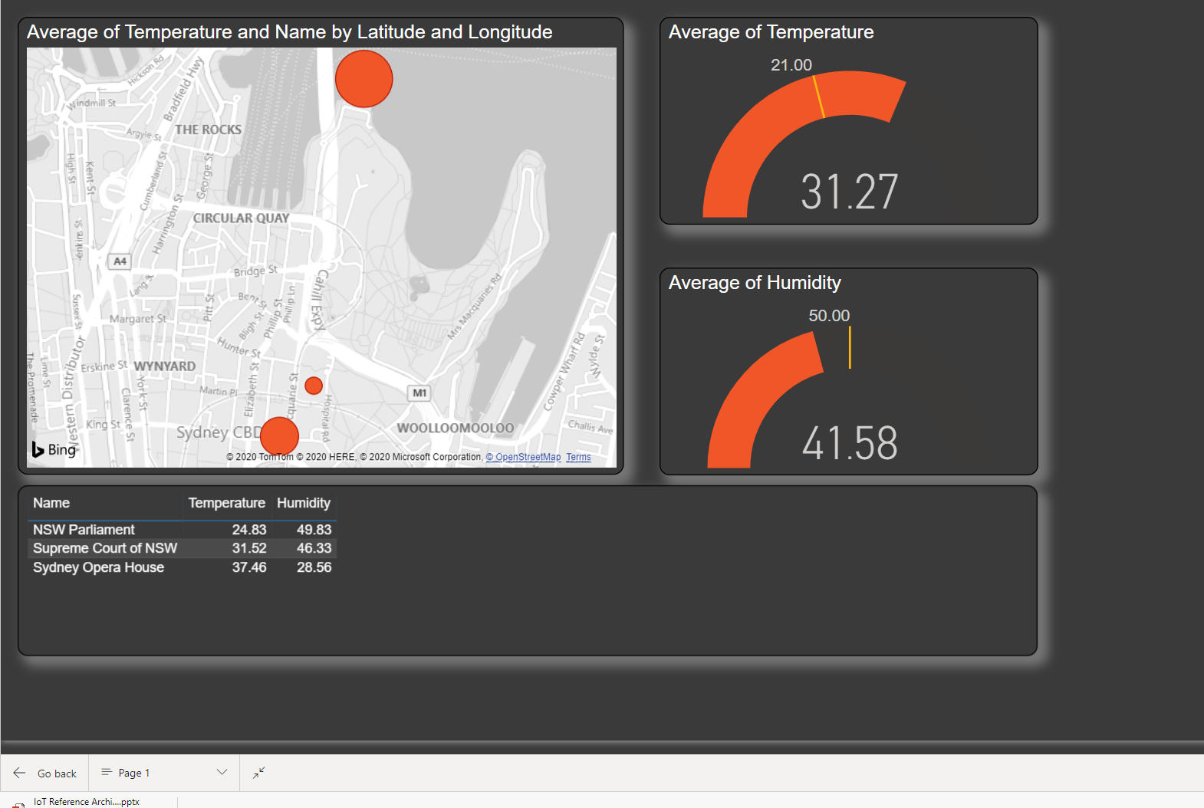



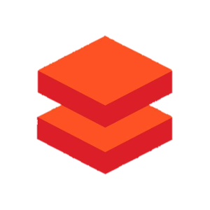

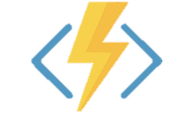

IoT Data: Azure IoT Smart Factory Architecture Scenario
Things
Insights
Actions
Storage
(Cold path)
Stream
processing
Cloud gateway
Azure IoT Hub
Stream Analytics
Message enrichment
Message partitioning
Cosmos DB
(Warm path)
Power BI
IoT Devices
HVAC msgs
Databricks
Azure Synapse
Security msgs
Device
twins
Databricks
Azure Functions
Lighting msgs
Event Hubs
Logic Apps
Notes:
Let's make the IoT Data architecture more concreate
And look how you would implement an Azure IoT solution to support a Smart Factory
The pattern and the services would be very similar for other scenarios
There is a lot going on
Break it down piece by piece to help you understand what is going on
Azure IoT hub is an internet scale secure messaging services, supports bidirectional communications, message enrichment and partitioning
Common services for Stream processing include Stream Analytics, Apache Spark streaming with Azure Databricks, and Azure Functions
And common endpoints include…
Actions and
Starting on the left
Databricks Unified Analytics Platform

Slide 66
Azure IoT Hub Message
{
"body": {
"Temperature": "30.25",
"Humidity": "54.0",
"Pressure": "1021.8"
},
"properties": {
"appid": "hvac",
"type": "telemetry",
"format": "json",
"version": "1",
"latitude": "-33.8767984",
"longitude": "151.2083053",
"name": "Sydney Factory"
}
}
{
"body": {
"Temperature": "30.25",
"Humidity": "54.0",
"Pressure": "1021.8"
},
"properties": {
"appid": "hvac",
"type": "telemetry",
"format": "json",
"version": "1",
}
}
Azure IoT Hub
Device twin
IoT Devices
Device twin document
"tags": {
"deploymentLocation": {
"name": "Sydney Factory",
"longitude": 151.2152,
"latitude": -33.85671,
}
Notes:
Device-to-cloud communications & Cloud to device comms
When sending information from the device app to the solution back end, IoT Hub exposes three options:
Device-to-cloud messages for time series telemetry and alerts.
Device twin's reported properties for reporting device state information such as available capabilities, conditions, or the state of long-running workflows. For example, configuration and software updates.
File uploads for media files and large telemetry batches uploaded by intermittently connected devices or compressed to save bandwidth.
Message comes into IoT Hub
In our example we have a telemetry message from a device
When the code was written for the device the developer can add known metadata
But the developer is unlikely to know where the device is being deployed or what the preferred device name will be
Every device registered has a device twin JSON metadata document
The initial state can be set by the device provisioning service and your application
This JSON document includes tags – data about the device, and desired and reported properties
Tags can include arbitrary data – in our case the device lat/long location and the device name
The device twin tag can be added to the message metadata as it flows through the system
So we now have richer information about the message will be useful as the message flows through the system.

Slide 67
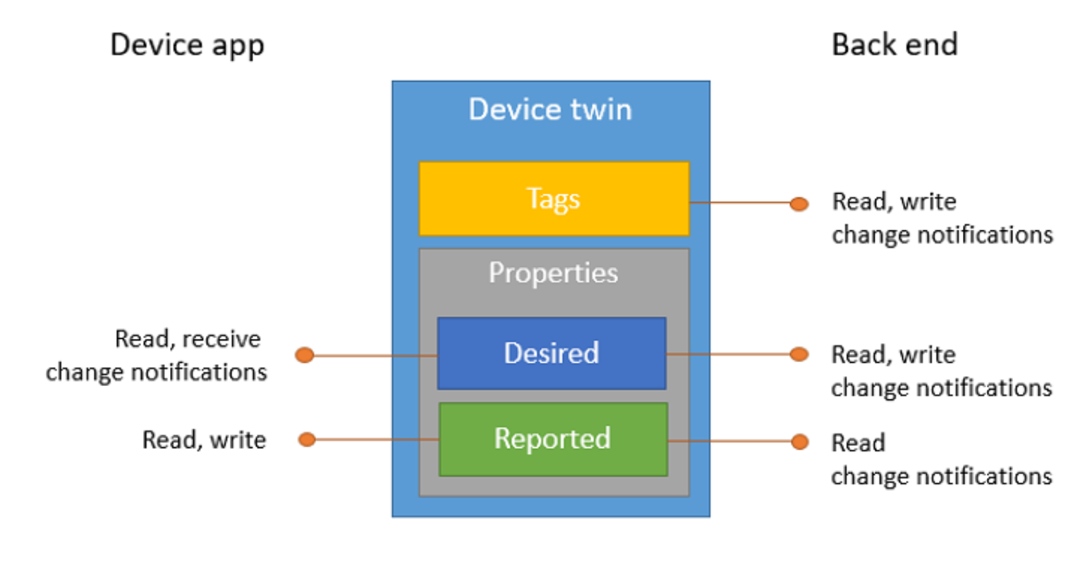
Device Twin
{
"deviceId": "devA",
"authenticationType": "sas",
},
"version": 2,
"tags": {
"deploymentLocation": {
"name": "Sydney Factory",
"longitude": 151.2152,
"latitude": -33.85671,
}
},
"properties": {
"desired": {
"telemetryConfig": {
"sendFrequency": "5m"
},
"$metadata" : {...},
"$version": 1
},
"reported": {
"telemetryConfig": {
"sendFrequency": "5m",
"status": "success"
},
"batteryLevel": 55,
"$metadata" : {...},
"$version": 4
}
}
}
Device Twin
Bi-directional device<->hub communication channel
Based on per-device (per module) json documents
Used to store configuration and control-plane state
Supports queries
Device Twin sections
Tags: set by service and not viewable by device
Desired properties: set by service and delivered to device
Reported properties: set by devices and delivered to service
Tags
Desired properties
Reported properties
Notes:
Device twins are JSON documents that store device state information including metadata, configurations, and conditions. Azure IoT Hub maintains a device twin for each device that you connect to IoT Hub.
The lifecycle of a device twin is linked to the corresponding device identity. Device twins are implicitly created and deleted when a device identity is created or deleted in IoT Hub.
Device twins store device-related information that:
Device and back ends can use to synchronize device conditions and configuration.
The solution back end can use to query and target long-running operations.
The lifecycle of a device twin is linked to the corresponding device identity. Device twins are implicitly created and deleted when a device identity is created or deleted in IoT Hub.
A device twin is a JSON document that includes:
Tags. A section of the JSON document that the solution back end can read from and write to. Tags are not visible to device apps.
Desired properties. Used along with reported properties to synchronize device configuration or conditions. The solution back end can set desired properties, and the device app can read them. The device app can also receive notifications of changes in the desired properties.
Reported properties. Used along with desired properties to synchronize device configuration or conditions. The device app can set reported properties, and the solution back end can read and query them.
Device identity properties. The root of the device twin JSON document contains the read-only properties from the corresponding device identity stored in the identity registry. Properties connectionStateUpdatedTime and generationId will not be included.
This article describes:
The structure of the device twin: tags, desired and reported properties.
The operations that device apps and back ends can perform on device twins.
Use device twins to:
Store device-specific metadata in the cloud. For example, the deployment location of a vending machine.
Report current state information such as available capabilities and conditions from your device app. For example, a device is connected to your IoT hub over cellular or WiFi.
Synchronize the state of long-running workflows between device app and back-end app. For example, when the solution back end specifies the new firmware version to install, and the device app reports the various stages of the update process.

Slide 68
Cloud-to-device communications
IoT Hub provides three options for device apps to expose functionality to a back-end app:
Direct methods for communications that require immediate confirmation of the result.
Twin's desired properties for long-running commands intended to put the device into a certain desired state.
Cloud-to-device messages for one-way notifications to the device app.
Notes:
Data Flow
Direct methods for communications that require immediate confirmation of the result.
Direct methods are often used for interactive control of devices such as turning on a fan.
Twin's desired properties for long-running commands intended to put the device into a certain desired state.
For example, set the telemetry send interval to 30 minutes.
Cloud-to-device messages for one-way notifications to the device app.
Direct Methods: Two-way. The device app can respond to the method right away. The solution back end receives the outcome contextually to the request.
Twin's desired properties: One-way. The device app receives a notification with the property change.
Cloud to device messages: One-way. The device app receives the message

Slide 69
Azure IoT Hub Messaging Routing and Partitioning
Azure IoT Hub
Endpoint Partitioning
Message partitioning
{
"body": {
"Temperature": "30.25",
"Humidity": "54.0",
"Pressure": "1021.8"
},
"properties": {
"appid": "hvac",
"type": "telemetry",
"format": "json",
"version": "1",
"latitude": "-33.8767984",
"longitude": "151.208305",
"name": "Sydney Factory"
}
}
Rules based message routing
appid = 'hvac’
and
type = 'telemetry'
HVAC telemetry Event hub
HVAC msgs
Security telemetry
Event hub
Security msgs
Lighting telemetry
Event hub
Lighting msgs
Audit cold path
Azure storage
Notes:
Use IoT Hub message routing to send device-to-cloud messages to different endpoints
Our system must deal with messages arriving from a range of devices
There could be telemetry messages arrive HVAC systems, security sensors, lighting systems etc
Each message will have a different format, different time vale, destined for different back end systems etc
Now there are two patterns you could deploy to deal with this complexity
Now we could have 1 IoT hub per device type and application but that would quickly become expensive and difficult to manage
Or more likely you have a consolidated set of IoT hubs and as messages flow into the system you will partition the messages ideally based on metadata but if JSON serialised message then you can also use the body of the message to route messages.
I’m going to assume you will most like what you use a consolidated set of IoT Hubs and route the messages
To that end IoT hub includes the alibility to route messages to different endpoints typically based on application, but could also include logging all messages entering the system for audit
An IoT hub has a default built-in-endpoint (messages/events) that is compatible with Event Hubs. You can create custom endpoints to route messages to by linking other services in your subscription to the IoT Hub.
Message enrichments describes the ability of Azure IoT Hub to stamp messages with additional information before the messages are sent to the designated endpoint.
IoT Hub currently supports the following endpoints:
Built-in endpoint
Azure Storage
Service Bus Queues and Service Bus Topics
Event Hubs
There are two storage services IoT Hub can route messages to -- Azure Blob Storage and Azure Data Lake Storage Gen2 (ADLS Gen2) accounts. Azure Data Lake Storage accounts are hierarchical namespace-enabled storage accounts built on top of blob storage. Both of these use blobs for their storage.
Non-telemetry events
In addition to device telemetry, message routing also enables sending device twin change events, device lifecycle events, and digital twin change events. For example, if a route is created with data source set to device twin change events, IoT Hub sends messages to the endpoint that contain the change in the device twin. Similarly, if a route is created with data source set to device lifecycle events, IoT Hub sends a message indicating whether the device was deleted or created.

Slide 70
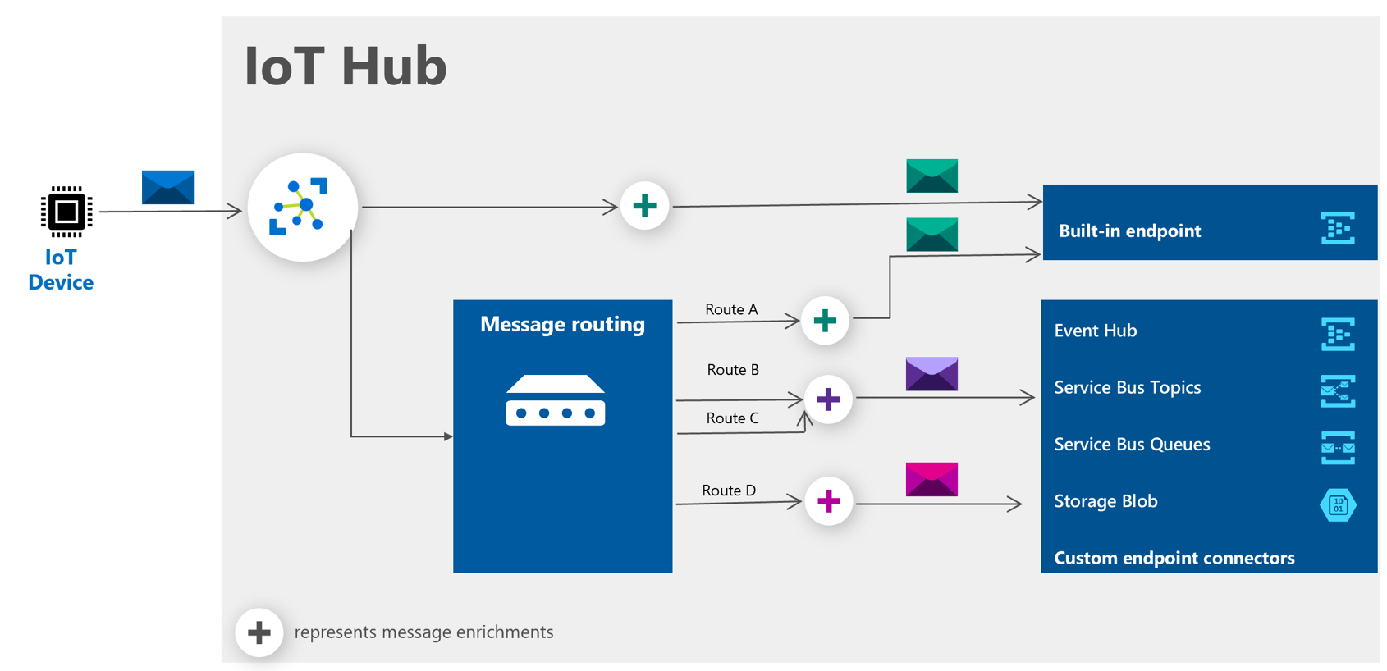
IoT Hub Message Routing and Message Enrichments
Enrichment Values supported
Device Twin tags, properties
IoT Hub name
Static string
Notes:
An IoT hub has a default built-in-endpoint (messages/events) that is compatible with Event Hubs. You can create custom endpoints to route messages to by linking other services in your subscription to the IoT Hub.
Message enrichments describes the ability of Azure IoT Hub to stamp messages with additional information before the messages are sent to the designated endpoint.
IoT Hub currently supports the following endpoints:
Built-in endpoint
Azure Storage
Service Bus Queues and Service Bus Topics
Event Hubs
There are two storage services IoT Hub can route messages to -- Azure Blob Storage and Azure Data Lake Storage Gen2 (ADLS Gen2) accounts. Azure Data Lake Storage accounts are hierarchical namespace-enabled storage accounts built on top of blob storage. Both of these use blobs for their storage.
Non-telemetry events
In addition to device telemetry, message routing also enables sending device twin change events, device lifecycle events, and digital twin change events. For example, if a route is created with data source set to device twin change events, IoT Hub sends messages to the endpoint that contain the change in the device twin. Similarly, if a route is created with data source set to device lifecycle events, IoT Hub sends a message indicating whether the device was deleted or created.

Slide 71
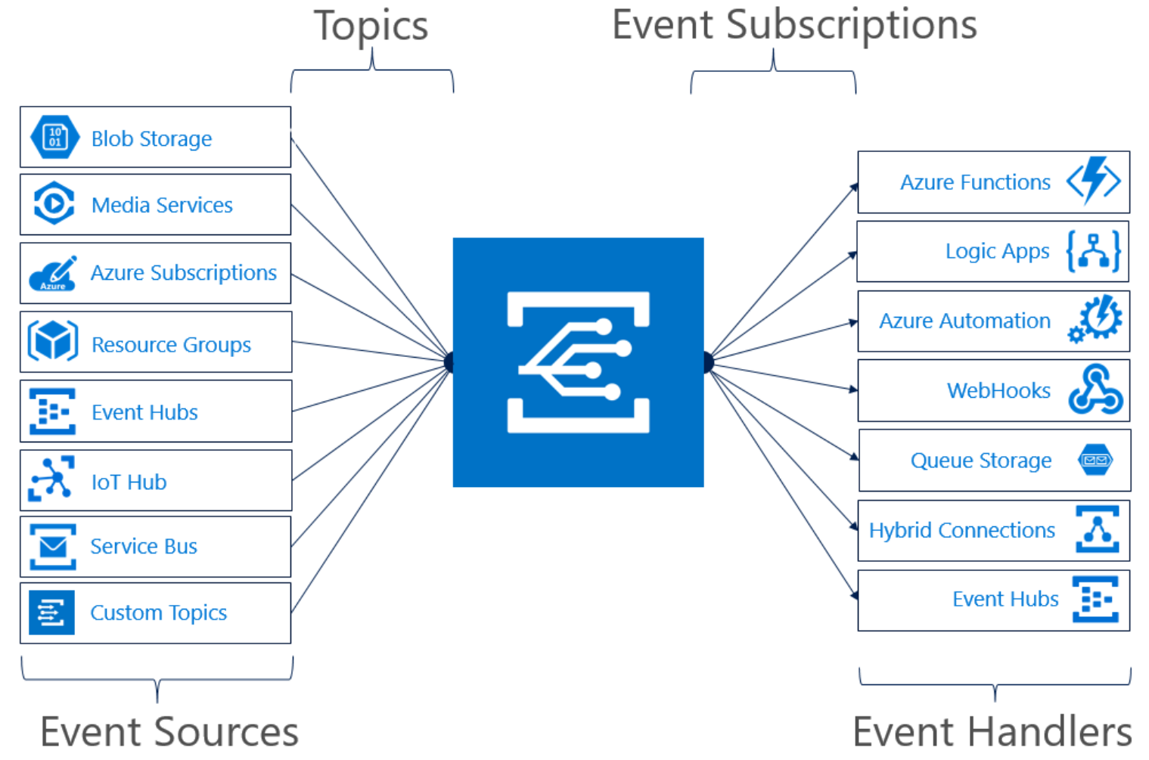
Serverless Integration
Events supported:
Device Telemetry
Device Created/Deleted Events
Device Connected/Disconnected Events
Notes:
Azure IoT Hub integrates with Azure Event Grid so that you can send event notifications to other services and trigger downstream processes.
For example: If I wanted to create an alert to send an email whenever a new device is created, I could create a Logic App and IoT Hub event subscriptions
Filter events
IoT Hub event subscriptions can filter events based on event type, data content and subject, which is the device name.

Slide 72

NEW: Device Update for IoT Hub
is an end-to-end platform for publishing, distributing, and managing over-the-air updates for IoT devices – from tiny sensors to gateway-level modules
Notes:
To address these key customer pain-points, we are expanding the management capabilities provided to you by Azure IoT platform, by introducing the new Device Update for IoT Hub.
Device Update for IoT Hub is an end-to-end platform for IoT device builders and solution integrators who want their customers to get the most value from their Azure IoT-enabled products. The platform simplifies and accelerates the time-consuming task of keeping every device across an IoT ecosystem up to date with the latest security and feature updates.
----------
Device Update for IoT Hub provides an on-network caching solution to enable updating of more complex topologies involving internet-isolated leaf and Nested Edge devices and is compatible with open-source solutions. It implements robust security measures for a safe updating experience, while rich management controls and reporting ensure that customers stay in control of the update process.
Device Builders: Whether you or your customers will be responsible for updating the devices you sell, you can make your IoT products more compelling for potential customers by preinstalling Device Update for IoT Hub so keeping devices updated is simple, secure, and reliable.
Solution Integrators & Device Builders: If you manage or deploy updates for customers, Device Update for IoT Hub has the capabilities you need to rapidly deploy over-the-air updates for everything from tiny sensor devices to gateway-level devices.

Slide 73





Device Update for IoT Hub Robust features for every IoT ecosystem
APIs make it easy to build your own portals and clients
Seamless UX Integration with Azure IoT Hub
Broad support for IoT operating systems, extensible via open source
Microsoft Connected Cache enables you to easily update devices downstream of a gateway and in nested topologies
Robust scheduling, notification, and reporting tools help keep you informed and in control
Notes:
Let's take a look at the features that are provided with Device Update-
Device Update provides APIs for importing, distributing and managing updates, so partners can choose to build their own custom portal and experiences on top of it
We also provide a seamless UX experience in Azure Portal integrated with IoT Hub
There is broad support for various IoT operating systems like Linux, Azure RTOS and platforms like Azure IoT Edge and Azure Percept. All of our agents are completely open-source so they can be extended to any configuration that you have running in your ecosystem
A unique offering of Device Update is the in-built support for Microsoft Connected Cache that enables updates for cloud disconnected devices downstream of an Edge gateway as well as in nested topologies
And lastly, Device update provides robust management and reporting tools that help keep customers informed and in control of the update process

Slide 74

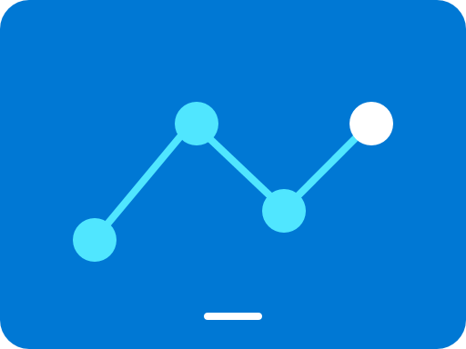



How Device Update for IoT Hub works in the real world
8.
View reporting
7.
6.
Deploy and monitor updates
5.
Import updates
IoT Hub
4.
Group devices
Device Update
3.
Provision devices with Device Update agent
Easily connect
2.
Manage access
1.
Subscribe
Notes:
Now let's take a look at how you can get started with Device Update for IoT Hub.
You can provision the Device Update resource from the Azure Marketplace on a new or existing Azure subscription. Provide access to different users or groups within your organization to the platform. You can connect a Device Update instance to a new or existing IoT Hub. Next, you have to install and provision the device update agent on your IoT device. You can use IoT Hub tags to group various devices which enable you to gradually deploy your update. For example you may group devices based on whether they are test or production, based on the region where they are deployed etc. Next import an update into your Device Update instance and then schedule a deployment to the group of devices you created above. You can then monitor the status to discover which of your devices are compliant with the latest update and which devices are not.
Subscribe – Select a subscription and provision the platform. A free introductory trial is available
Manage access – Select the people you want to have the ability to provision or access the platform
Easily connect – Select the IoT Hub instance you want to manage
Provision devices with Device Update agent – Quickly integrate Device Update for IoT Hub capabilities into your client software
Group devices – Group devices by class and schedule when updates occur.
Import updates – Import the security or new feature updates you require.
Deploy and monitor updates – Push security or feature updates to devices and receive real-time status notifications
View reporting – Robust reporting capabilities make it easy to keep track of updates and provide up-to-date documentation
New users can get started by going to Azure.com, which has detailed information about the service. New users who want to try out Device Update for Azure IoT Hub can use a free tier without being charged up to a defined threshold. Solution operators are then able to select a resource group and region and then specify the name of the Device Update for Azure IoT Hub resource instance and the Azure AD directory to be associated with this instance. The user can subsequently see the status of the update being provisioned and then manage the update once provisioning is complete. IoT solution operators and team leaders can select who is given Device Update for Azure IoT Hub provisioning access within their organizations, as well as specifying the users who can manage update instances, try out the functionality, and who can publish or deploy updates.
Included with Device Update for Azure IoT Hub are features that allow maximum flexibility for updating devices:
Use information in Azure IoT Hub to enable a “cloud scan” or cloud orchestrator, where applicability and workflow is moved to the cloud rather than requiring on-device scans.
Automatically match updates imported into the system with compatible devices, making it easy to deploy the right updates to the right devices.
Easily subscribe to Device Update for Azure IoT Hub services through the Azure.com portal and provision update tenants.
Built-in capability to update cloud disconnected devices using an IoT Edge module called Microsoft Connected Cache. This allows disconnected devices to seamlessly download cloud-hosted update payload.

Slide 75
Demo

